Slide 1
The Bible,
Religion
and Rule

Slide 2
Great Comet of 44 BC was a seven-day cometary outburst seen in July 44 BC. It was interpreted by Romans as a sign of the deification of recently assassinated dictator, Julius Caesar (100–44 BC)
Herod the Great (Roman) b.72BC during the reign of Julius Caesar. Ruled from 37/36BC to 1/4AD
Successors: Herod Archelaus (son), Herod Agrippa I (grandson), Philip the Tetrarch, Salome I

Slide 3
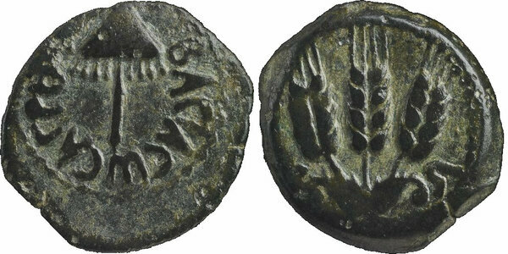
Herod Agrippa I
b. 11AD d. 44AD
Notes:
3

Slide 4
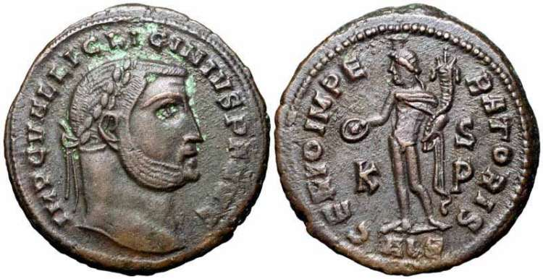
Licinius
Emp. 308-324AD
Notes:
4

Slide 5
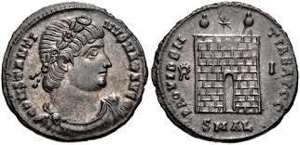
Constantine Camp Gate
Emp. 306-337AD
Notes:
5

Slide 6
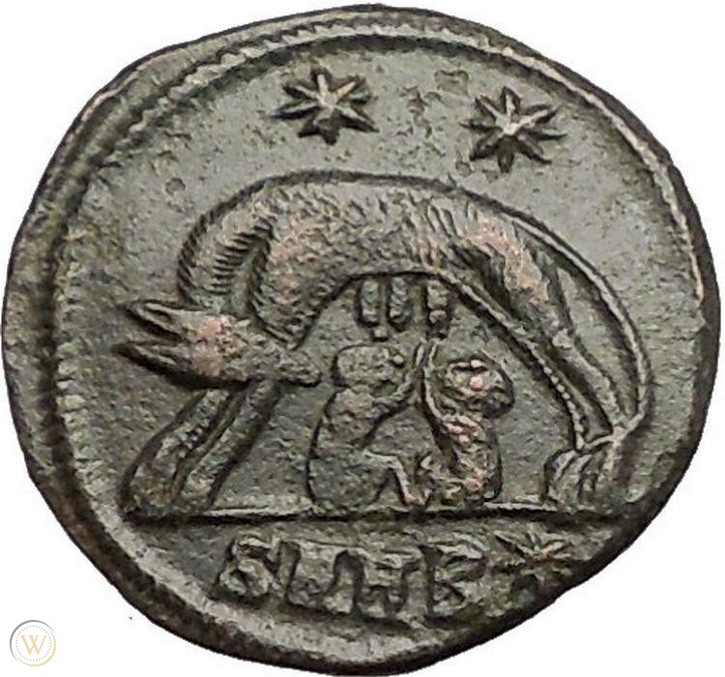
Notes:
6

Slide 7
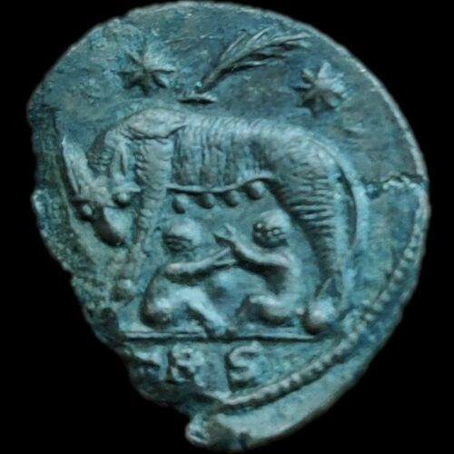
On February 16th, 336 A.D., a blazing comet foretold Constantine's death
Notes:
7

Slide 8
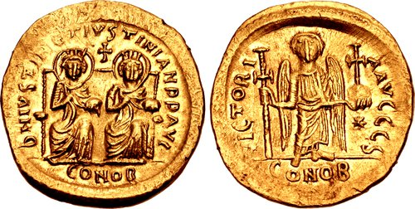
Justin I
Notes:
8

Slide 9
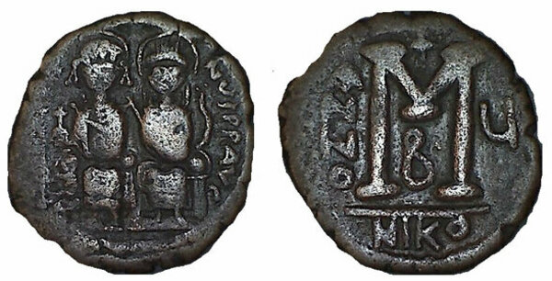
Justin II with Sophia
Notes:
9

Slide 10
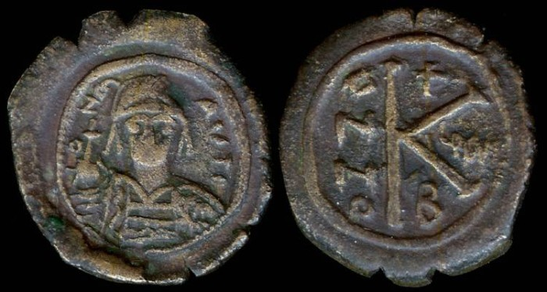
Maurice Tiberius
Notes:
10

Slide 11
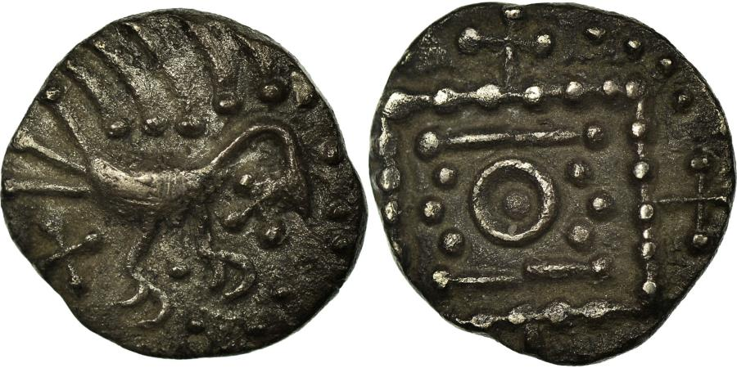
AngloSaxon Sceat
Notes:
11

Slide 12
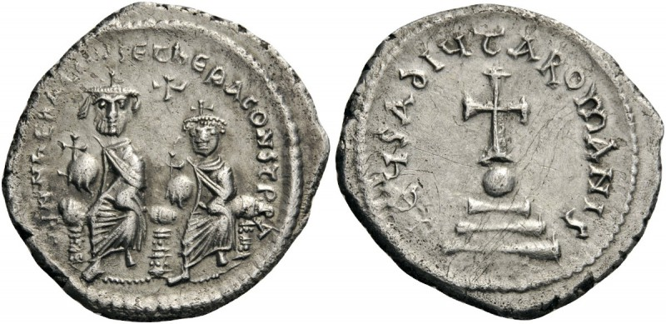
Heraclius
Notes:
12

Slide 13
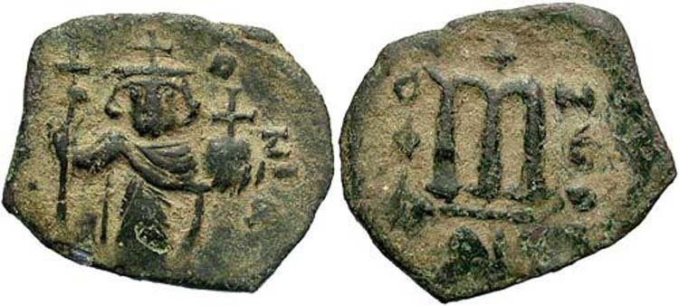
Constans II
Notes:
13

Slide 14
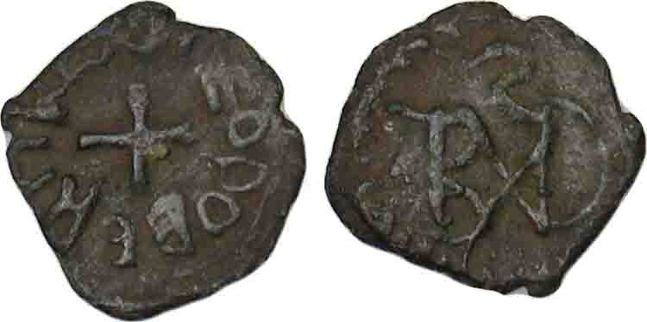
Frankish Coin
Notes:
14

Slide 15
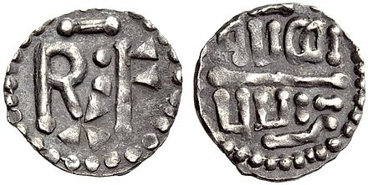
Pippin III
Notes:
15

Slide 16
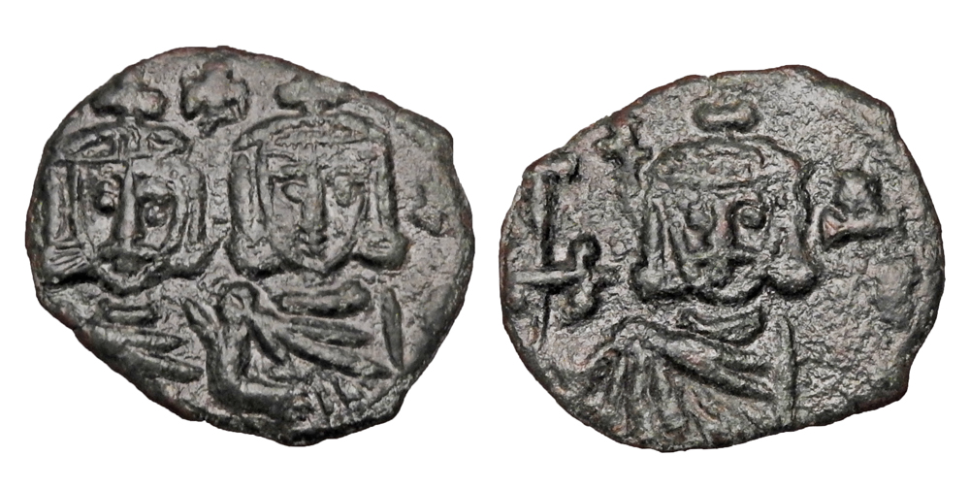
Constantine V
Notes:
16

Slide 17
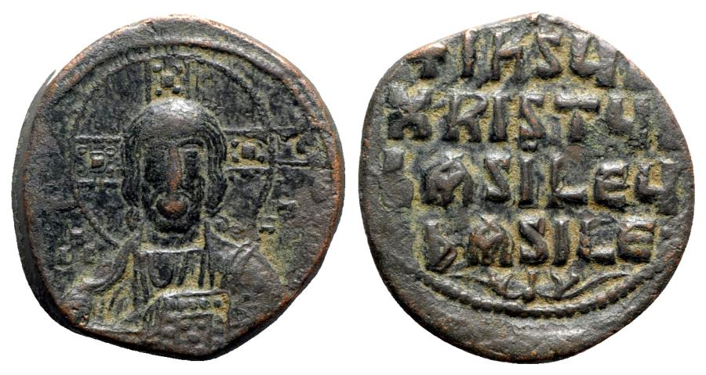
Basil II
Notes:
17

Slide 18
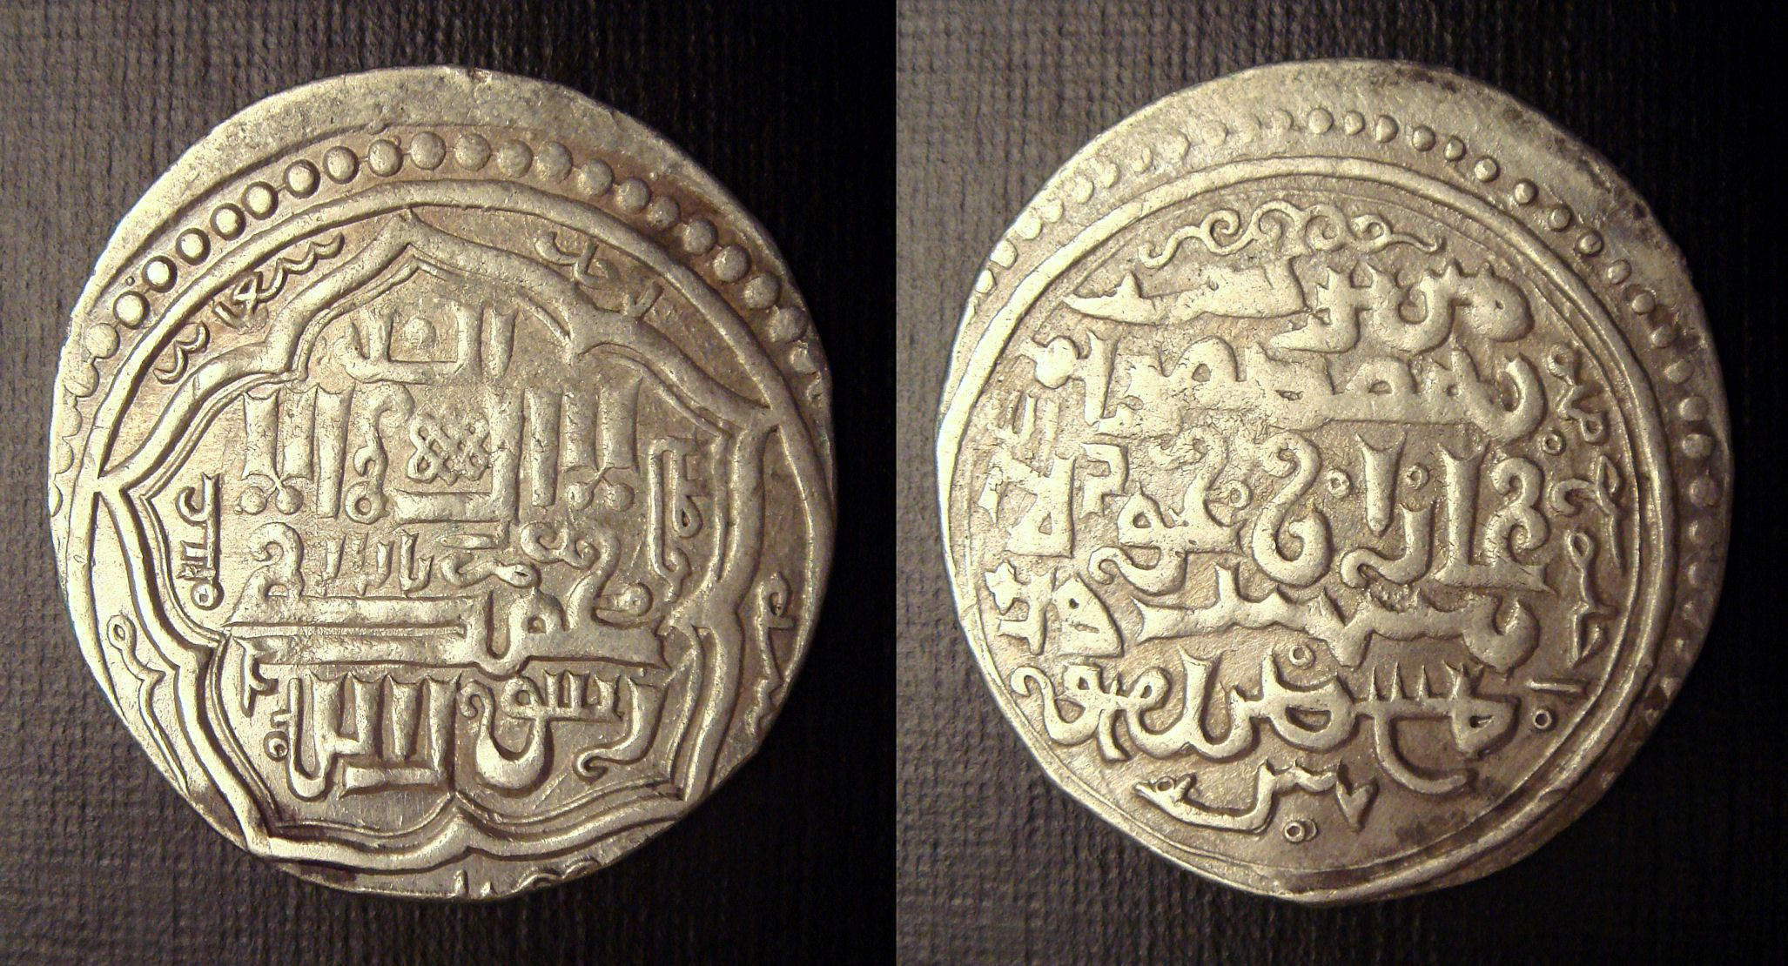
Mas’ud Ibn Mahmud
Notes:
18

Slide 19
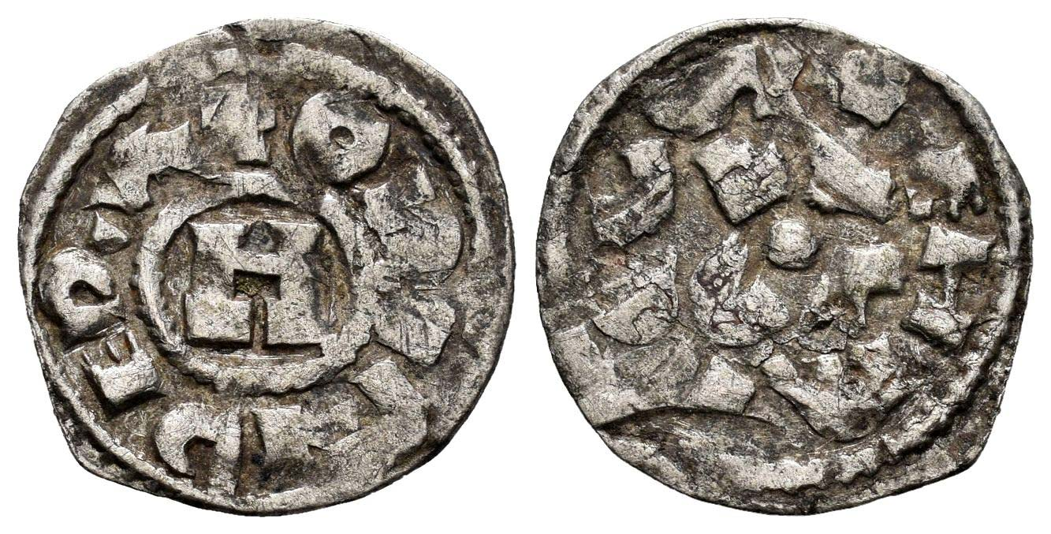
Lucca - Henry III - V
Notes:
19

Slide 20
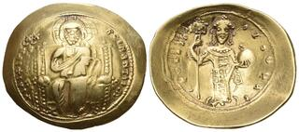
Constantine XI
Notes:
20

Slide 21
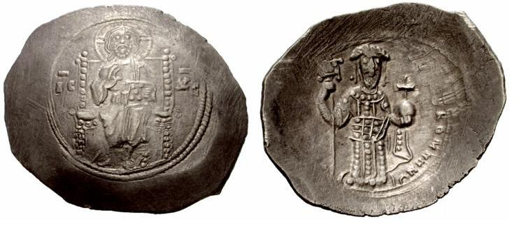
Alexius I
Notes:
21

Slide 22
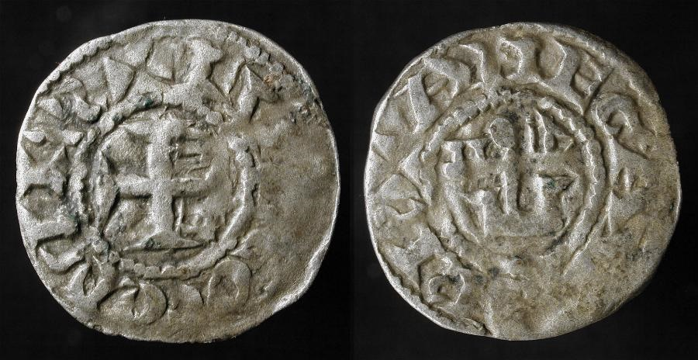
Foulques V
Notes:
22

Slide 23
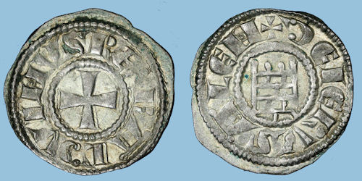
Baldwin III
Notes:
23

Slide 24
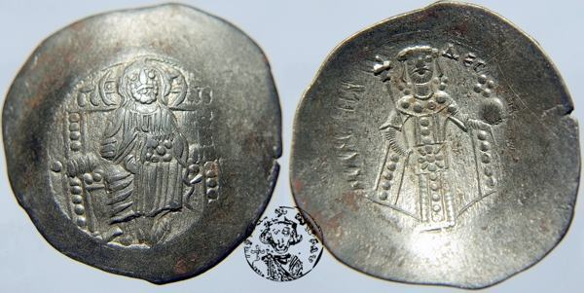
Manuel I
Notes:
24

Slide 25
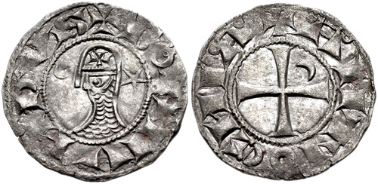
Bohemund III
Notes:
25

Slide 26
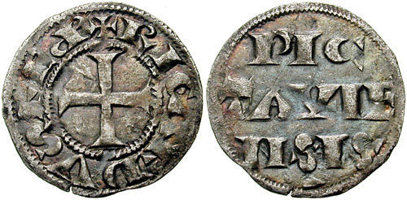
Richard I
Notes:
26

Slide 27
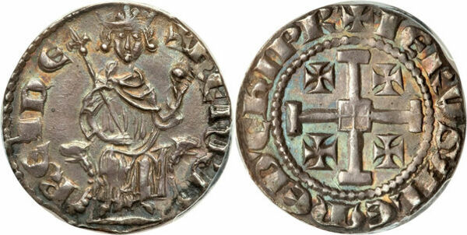
Henry II - Cyprus
Notes:
27

Slide 28
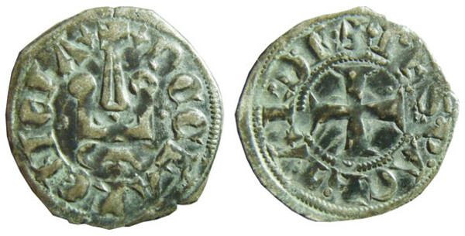
Philip de Savoy
Notes:
28

Slide 29
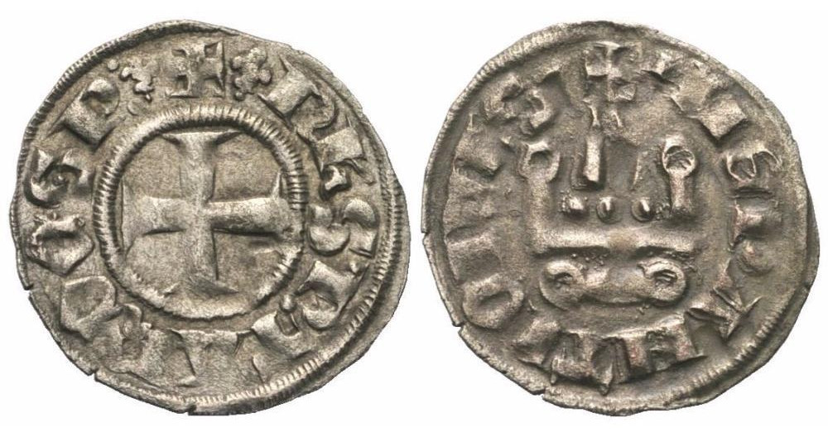
Philippe de Tarente
Notes:
29

Slide 30
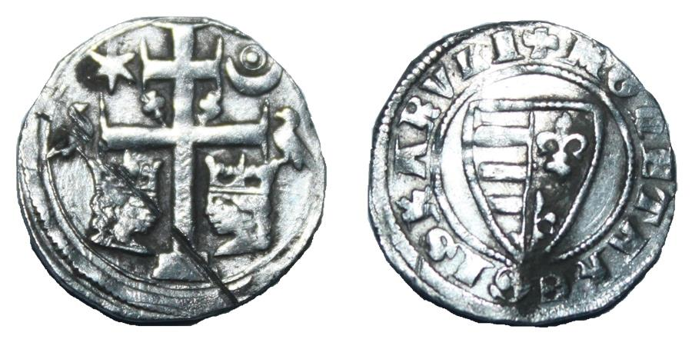
Charles I – Hungary & Croatia
Notes:
30

Slide 31
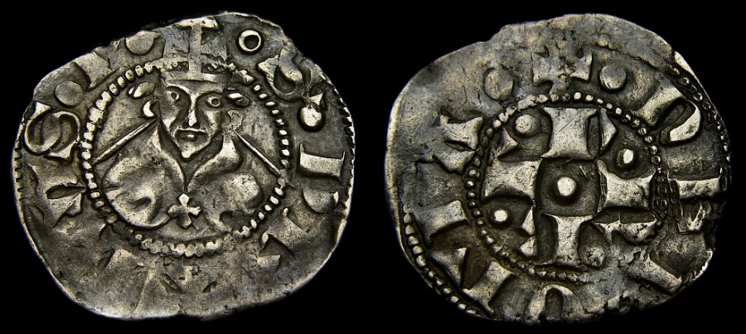
Pope Urban V
Notes:
31

Slide 32
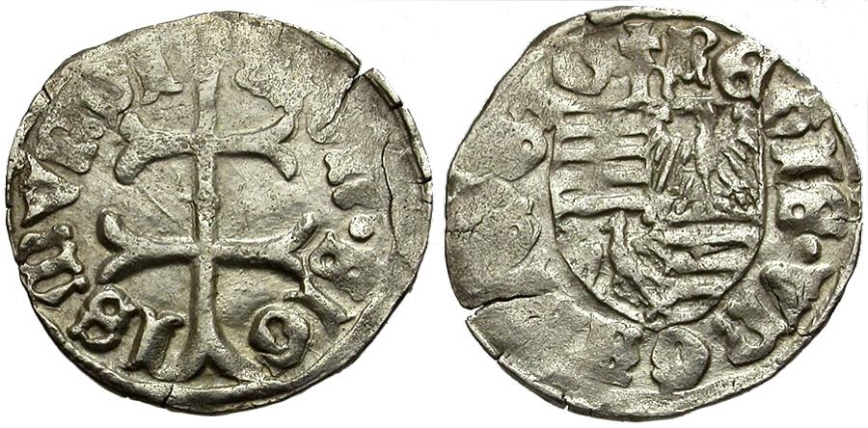
Sigmund I - Hungary
Notes:
32

Slide 33
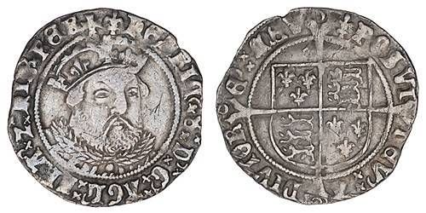
Notes:
33

Slide 34
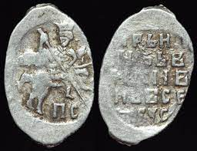
Ivan the Terrible
Notes:
34

Slide 35
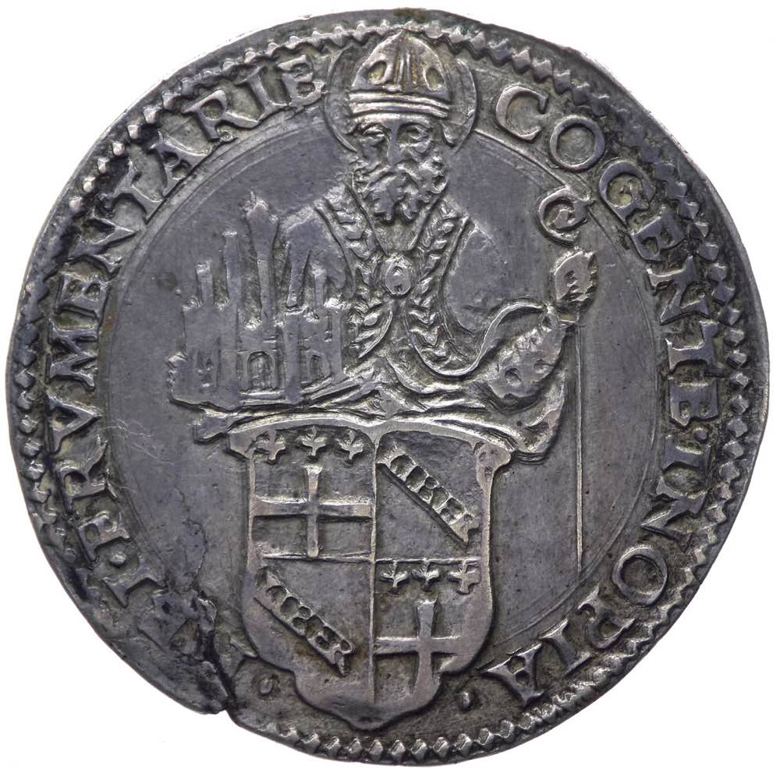
Pope Clement VII
Notes:
35

Slide 36
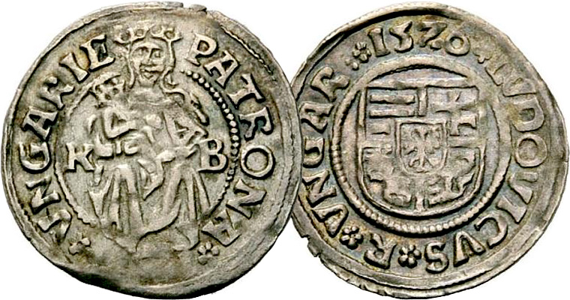
Ferdinand I
Notes:
36

Slide 37
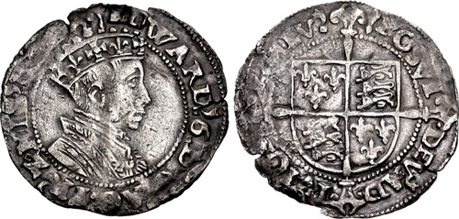
Edward VI
Notes:
37

Slide 38
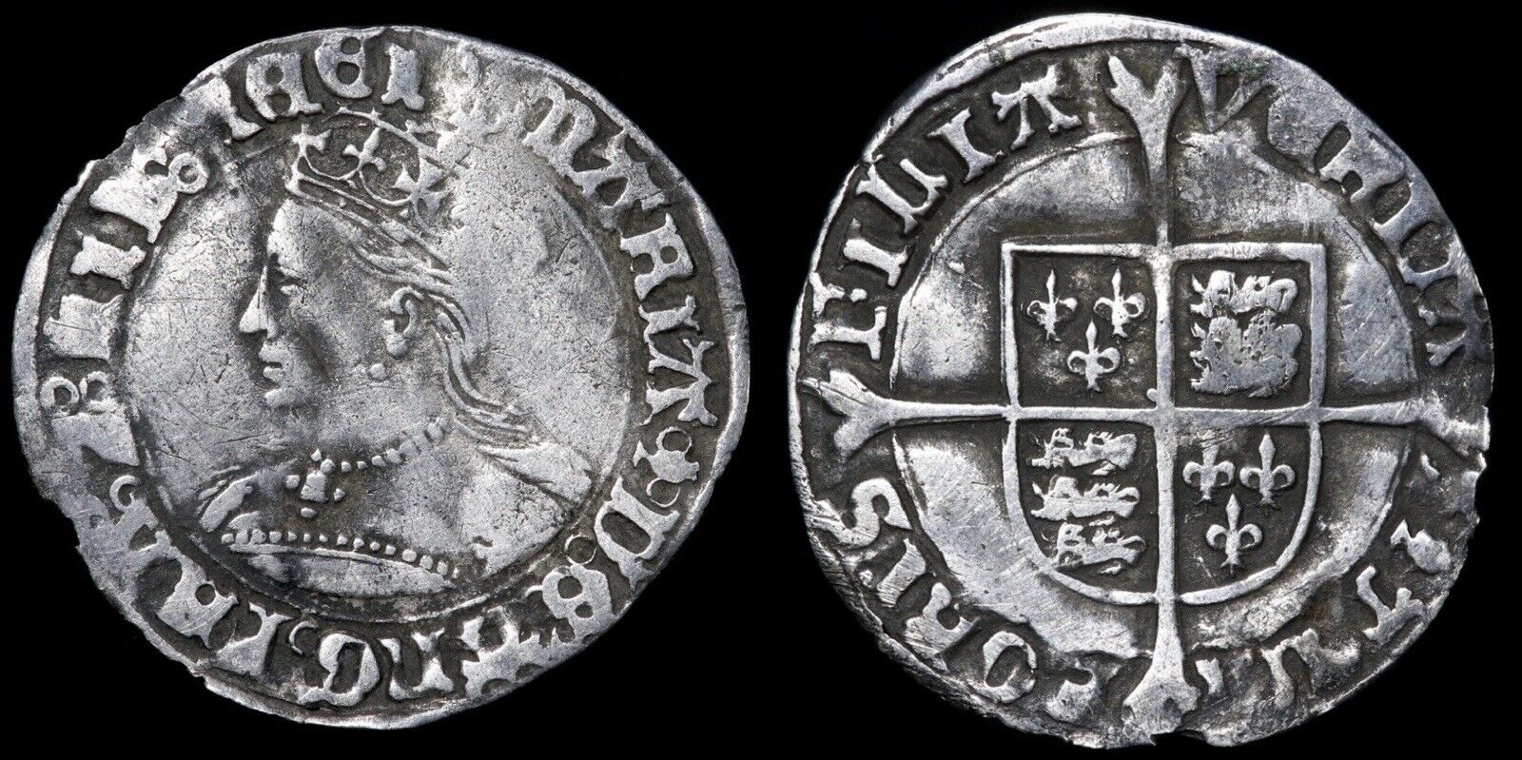
Mary Tudor
Notes:
38

Slide 39
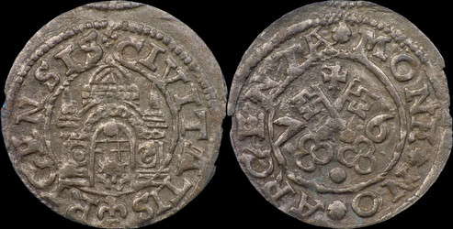
Freedom of the City of Riga
Notes:
39

Slide 40
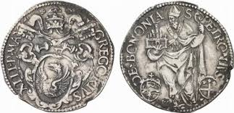
Pope Gregory XIII
Notes:
40

Slide 41
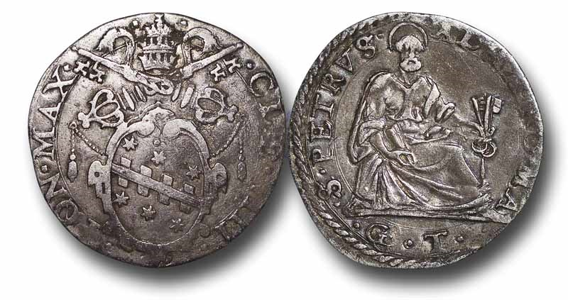
Clemens VII
Notes:
41

Slide 42
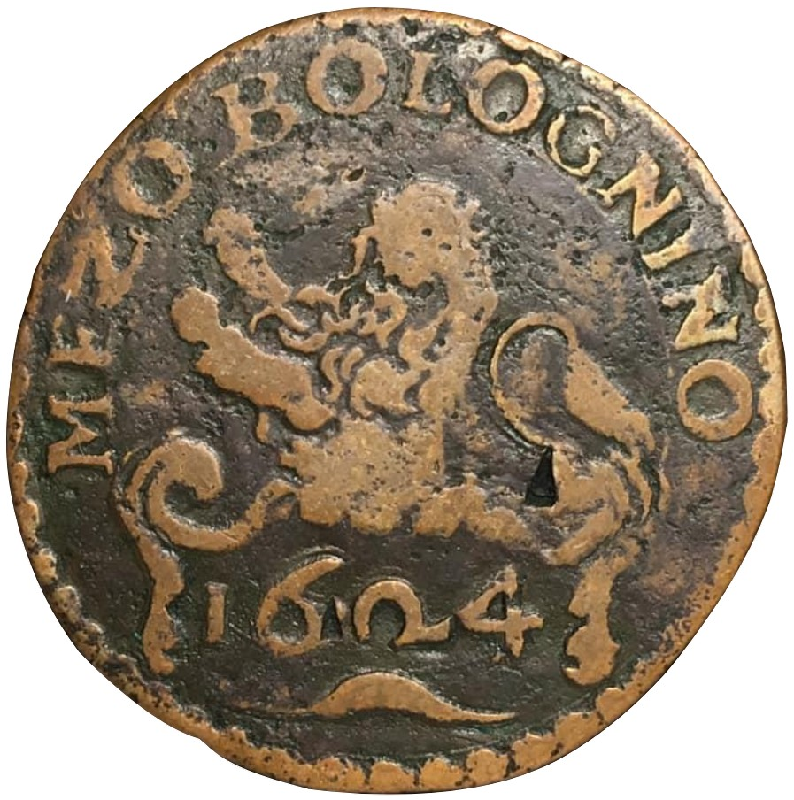
Papal States - Bologna
Notes:
42

Slide 43
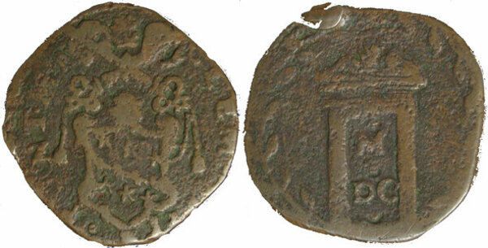
Clement VIII
Notes:
43

Slide 44
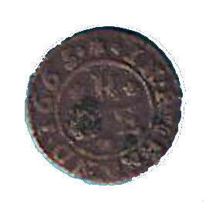
Richmond 1665
(Plague)
Notes:
44

Slide 45
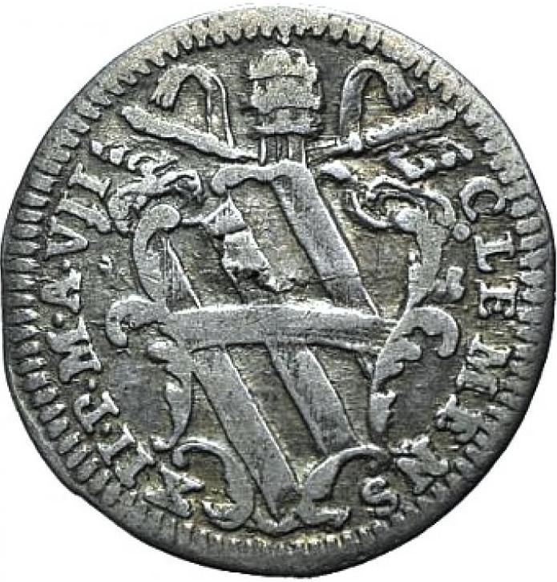
Clementi XII
Notes:
45

Slide 46
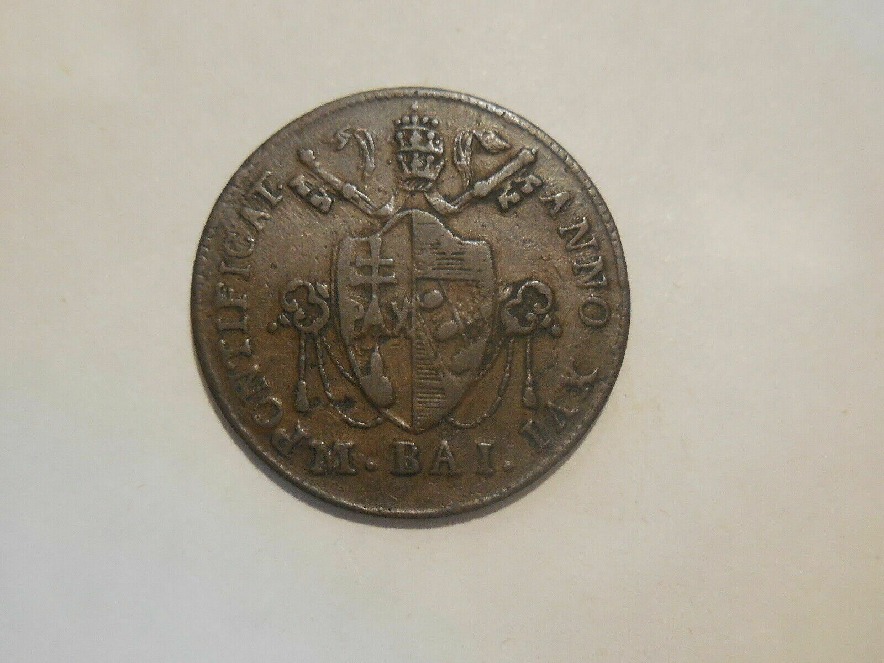
Pius VII
Notes:
46

Slide 47
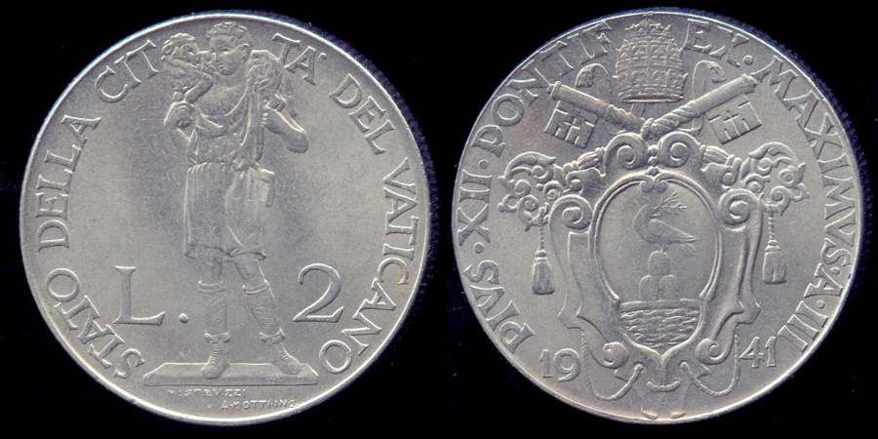
Pius XII
Notes:
47

Slide 48
Notes:
48

