Slide 1
A community is a group of people who share common characteristics, interests, values, or goals and interact with one another.

Slide 2
Inkpen Community From Saxon times to Now

Slide 3
Saxon Times

Slide 4
1. Settlement & Economy
Villages: Small, dispersed farming communities (e.g., Reading = "Reada's people," Wallingford = "ford of the Wealh people").
Agriculture: Fertile Thames Valley soils grew barley, wheat, and oats; pigs foraged in beech woods (e.g., Windsor Forest).
Trade: Rivers Thames and Kennet enabled trade; Wallingford was a key market.
2. Society
Thegns: Local elites (e.g., thegns of Cookham held land from Edward the Confessor).
Peasants: Mostly free ceorls, with some geburs (tenant farmers).
Defense: Earthwork forts like Wallingford (built by Alfred the Great against Vikings).
3. Religion
Minster Churches: Important at Abingdon (founded in 675) and Sonning.
Pagan Remnants: Sacred springs (e.g., St. Anne’s Well, Caversham) later Christianized.
4. Daily Life
Homes: Timber-framed longhouses with wattle-and-daub walls.
Food: Ale, bread, river fish (eel traps common), and wild game.

Slide 5
Legacy in Modern Words
"Husband" = hūsbōnda (householder).
"Lady" = hlǣfdīge (loaf-kneader).
"Wedlock" = wed (pledge) + lac (gift).

Slide 6
Anglo-Saxon and Old English names, Edward, Alfred and Wilfred are still popular. There aren't as many recognisable female names, but they include Audrey, Edith, Ethel, Hilda and Mildred.
The English language is still strewn with a vast number of Saxon and Anglo-Saxon words. Candeltreow – Candle stick, Hleahtor – Laughter, Frumbyrdling – a young boy’s first beard.
The language lives on …..

Slide 7
Religion & Superstitions
Early Paganism: Charms for good harvests, worship at sacred trees/springs.
Christian Influence (from 7th century): Sunday Mass, saints’ feast days, and tithes to the church.
Folk Beliefs: Fear of elves, witches, and the "night-walker" (undead spirits).

Slide 8
Women’s Legal Status
Marriage: Brides had morning-gifts (property from husbands).
Divorce: Allowed (but rare); women could leave abusive marriages.
Rights: Could own land, sue in court, and run businesses.

Slide 9
Land & Property Laws
Folkland: Communal land granted by kings to thegns for loyalty.
Bookland: Land given to the Church (permanent, written charters).
Inheritance: Sons typically inherited, but women could hold property (e.g., widows kept 1/3 of marital land) c.f. will of Wulfgar: 939 AD

Slide 10
Health & Medicine
Illnesses: Arthritis, tooth decay, and infections (no antibiotics. Antibiotics became widely available for public use starting in 1945).
Cures: Herbal remedies (honey for wounds, garlic for infections), bloodletting, and prayers to saints.
Life Expectancy: ~30–40 years (childbirth and disease were deadly).
(In early Victorian times (roughly 1837-1850), the life expectancy for women at birth was around 42 years.)

Slide 11
The majority of people at that time were illiterate. This usually included the Thegn, the Lord of the Manor.
Most transactions, deeds, literature etc. were committed to memory and relayed in an oral way.

Slide 12
Crimes Likely in a village like Inkpen in Anglo-Saxon Time
Crimes Against the Person
Assault or brawling: Disputes between villagers, often settled with fines.
Murder or injury: Rare but serious; resolved through wergild payments.
Crimes Against Property
Theft of livestock or crops: Common in agrarian communities.
Poaching: Hunting on noble or church lands without permission.
Arson: Burning barns or homes — a grave offense.
Crimes Against Order
Breaking the peace: Drunkenness or disorderly conduct.
Insulting a neighbour: Could disrupt village harmony and lead to fines.
Failure to join the hue and cry: If someone ignored a call to chase a criminal, they could be fined.

Slide 13
Fines and Compensation
Wergild: Paid to the victim’s family. For example:
  Thegns: 100 shillings
  Serf: 40 shillings
Botgild: Compensation for injuries (e.g., 60 shillings for a nose, 9 for a toe).
Corporal and Public Punishment
Stocks or pillory: Public humiliation in the village center.
Mutilation: Repeat offenders might lose a hand or ear.
Trial by Ordeal
Hot iron or boiling water: Used when guilt couldn’t be proven by witnesses.
Cold water: Floating meant guilt; sinking meant innocence (but risky).
Other Sentences
Exile: Banishment from the village.
Slavery: If unable to pay fines.
Execution: Reserved for treason or serious repeat offenses.

Slide 14
Standard Crimes & Punishments
Theft: Hanging or fines (hand-cutting for repeat offenders).
Murder: Paid via wergild or execution if unpaid.
Treason: Death (e.g., betraying a lord).
Witchcraft: Fines or exile (later, under Christian law, death).
Adultery: Fines (more severe for women).
Outlawry: Exile (effectively a death sentence—anyone could kill an outlaw).

Slide 15
What did the get up to during their Holidays

Slide 16
Seasonal and Lunar Festivals (Holidays)
Mōdraniht (Mothers’ Night): Celebrated on what we now call Christmas Eve, this was a sacred night honoring maternal figures and fertility. It marked the beginning of the new year.
Ēosturdæġ (Eostre’s Day): A spring festival named after the goddess Eostre, associated with dawn and renewal. It likely involved feasting and fertility rites — and yes, it’s the root of our modern Easter.
Midsumor: Held around the summer solstice, this was a celebration of light, warmth, and abundance.
Winterfylleþ: The “winter full moon” festival, marking the start of winter. It was tied to lunar cycles and may have involved offerings for protection and survival.
Blōtmōnaþ (Blood Month): November was the time for ritual animal sacrifices, both for food and spiritual purposes. It was a practical and sacred preparation for winter.
Ġēola (Yule): A midwinter celebration that later merged with Christian Christmas. It spanned several days and involved feasting, gift-giving, and honoring ancestors.

Slide 17
Rituals and Offerings
Blōt (sacrificial rites): Animals were offered to gods or spirits, especially during Blōtmōnaþ (Blood Month), to ensure good harvests or protection through winter.
Feasting: Communal meals were central—meat from sacrifices, ale, bread, and seasonal produce were shared in longhouses or open-air gatherings.
Bonfires and fire rituals: Especially during Ġēola (Yule) and Midsumor, fire symbolized renewal, protection, and the sun’s power.
Storytelling and Music
Scops (bards) performed epic tales, like Beowulf, accompanied by lyres or harps.
Songs and chants honored gods, ancestors, or seasonal changes.
Dramatic reenactments of mythic events or heroic deeds may have taken place, especially in warrior-centric communities.
Spiritual Reflection and Community Bonding
Honoring ancestors through quiet reflection or spoken remembrance.
Marriage ceremonies or handfastings often aligned with festivals like Eostre or Midsumor.
Games and contests—wrestling, archery, or riddles—fostered camaraderie and showcased skill.

Slide 18

An Inkpen woman in Anglo-Saxon times (400–1066)
"I am my own person. I can own land, speak in court, and choose my husband. I weave, I farm, I raise children. The Church respects my prayers, and my morning-gift is mine to keep. Life is hard, but I am not invisible."

Slide 19
Her Husband
"I work the land my father worked. I owe my loyalty to my lord and my tithing. If one of us errs, we all pay. I join the hue and cry when trouble stirs, and I stand before the reeve (magistrate) if accused. I drink ale with my kin, and I pray to the new God, though the old ways linger in my bones. Life is hard, but it is ours."

Slide 20
Life in Inkpen Now.
The sun hangs low over the wooded hills of Ingepenne. The air is thick with the scent of woodsmoke and damp earth, mingling with the rich aroma of roasting meat from the open hearth. Around me, the village folk gather in the open clearing at the heart of the settlement, their faces lit by the flickering glow of torches and the central fire.
The þegn (thegn), a local lord or warrior-leader, stands near the fire, his bronze brooch glinting as he speaks in a deep, measured voice. The people listen—some seated on rough-hewn benches, others on the ground, wrapped in thick woollen cloaks against the evening chill. Children dart between the adults, laughing, while dogs linger at the edges, hoping for scraps.
To one side, an old scop (poet) plucks a lyre, his voice rising in a tale of heroes and gods—perhaps of Beowulf or Woden’s wanderings. The words ripple through the crowd, some joining in with familiar refrains. A few women weave through the gathering with clay cups of medu (mead), its sweetness sharp on the tongue…….

Slide 21
Key Legal Concepts
Wergild ("Man-Price"):
  Compensation paid to a victim’s family for injury or death.
  Example: Killing a ceorl (free peasant) = 200 shillings, a thegn (noble) = 1,200 shillings.
  Body Parts: A thumb = 20 shillings, a nose = 60 shillings (Æthelberht’s laws listed rates for injuries!).
Oaths & Ordeals:
  Oath-helpers: Friends/villagers swore oaths to support an accused person’s innocence.
  Ordeals: Divine judgments (e.g., holding red-hot iron—if wounds healed, God declared innocence).
Blood Feuds:
  Families could avenge wrongs legally—but kings encouraged wergild to prevent endless violence.

Slide 22
Literature
Before the Norman Conquest, Anglo-Saxons heavily relied on oral tradition, with poets and bards passing down stories, poems, and historical accounts through spoken word.

Slide 23
Will of Wulfgar
A.D. 931 x 939 (probably 933 x 939). Will of Wulfgar, including bequests of land at Collingbourne Kingston, Wilts., to his wife Æffe, for life, with reversion to New Minster, Winchester; at Inkpen, Berks., to Æffe, for life, with reversion to the church at Kintbury, Berks.; at Cræft to Wynsige and Ælfsige; at Denford, Berks., to Æthelstan and Cynestan; 2 hides at Buttermere, Wilts., to Brihtsige and one of Ceolstan's sons; at Æscmere (cf. Ashmanworth, Hants.) 'to such of my young kinsmen as obey me best'; and at Ham, Wilts., to Æffe, for life, with reversion to Old Minster, Winchester.

Slide 24
Saxon times end
or do they?
Now is the start of Norman Times

Slide 25
We know more about Norman times because their information was written down!

Slide 26
The Conquest and DoomsDay!

Slide 27
Doomsday book reference to Inkpen
Land of William son of Ansculf
Households
Households: 10 villagers. 15 smallholders. 20 slaves.
Land and resources
Ploughland: 4 lord's plough teams. 7 men's plough teams.
Other resources: Meadow 16 acres. 1 mill, value 12 shillings and 5 pence.
Valuation
Annual value to lord: 12 pounds in 1086; 12 pounds when acquired by the 1086 owner; 14 pounds in 1066.
Owners
Tenant-in-chief in 1086: William son of Ansculf.
Lord in 1086: William son of Ansculf.
Overlord in 1066: King Edward.
Lord in 1066: free men, two.

Slide 28
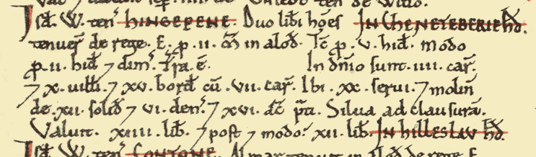

Slide 29
Notable Developments
Domesday Book: A landmark in administrative control, listing landholders, tenants, and resources.
Feudal Hierarchy: Reinforced social stratification—landholding defined status, duty, and power.
Legal Codification: Gradual shift from customary to written law, especially under Henry II’s reforms.

Slide 30
1. Land & Power Shifts
Domesday Book (1086): Berkshire’s lands seized by Normans.
  Wallingford: Granted to Robert D’Oilly, who built a stone castle.
  Windsor: William I expanded a Saxon hunting lodge into Windsor Castle.
Serfdom: Many free Saxons became villeins tied to manors (e.g., Bray, Cookham).
2. Village Changes
New Castles: Windsor and Wallingford dominated the landscape, disrupting Saxon fields.
Planned Towns: Norman lords founded Newbury (late 11th century) to control trade routes.
Forest Laws: Peasants faced harsh penalties for hunting deer.
3. Economy
Sheep Farming: Expanded for wool trade (Berkshire’s uplands ideal for grazing).
Mills: Normans built watermills (e.g., on the Kennet), charging peasants to grind grain.
4. Religion
Parish Churches: Replaced wooden Saxon chapels.
5. Daily Life Under Normans
Language: Manorial records in Latin/French; peasants still spoke Old English.
Food: More pork (Norman preference), but peasants ate simpler diets than lords.
Housing: Some stone cottages for stewards; peasants still in timber huts.

Slide 31
Name Survival: Evolved into Inkpen (recorded as "Inkepenne" in 1220).
Norman Architecture: St. Michael’s Church (Inkpen) has Norman-era foundations (though rebuilt later).
Folklore: Local tales of "Saxon ghosts" near the Beacon reflect cultural memory of displacement.
Inkepenne’s decline in value post-1066 mirrors wider patterns: Norman lords prioritized castles (e.g., Wallingford) over agrarian villages. Yet its name endured—a testament to Saxon resilience.

Slide 32
Before & After: A Saxon vs. Norman Village
Aspect | Saxon Village (Pre-1066) | Norman Village (Post-1066)
Lord | Saxon thegn (local noble) | Norman baron (often absentee)
Housing | Timber longhouses | Some stone cottages for stewards
Church | Small wooden chapel | Grand stone church
Work | Free peasants (ceorls) | Villeins (unfree, bound to land)
Language | Old English | French (lords), Old English (peasants)

Slide 33
Key elements of early Norman law in the 11th and 12th centuries:
Category | Anglo-Saxon Continuity | Norman Innovations
Legal Foundations | - Laws of Edward the Confessor upheld | - Centralization of legal authority
Law Enforcement | - Tithings (mutual responsibility) | - Murdrum fine for death of Normans
 | - Hue and cry | - Royal Forest Laws with harsh punishments
Language & Access | - English used in courts | - Norman French introduced, limiting access for English speakers
Judicial System | - Shire and Hundred Courts | - King's Court for major crimes
 |  | - Lords' Courts for feudal matters
 |  | - Church Courts for clergy and moral offences
Trial Methods | - Trial by ordeal (under Church) | - Trial by combat added
Punishments | - Wergild (victim compensation) | - Increased use of mutilation, fines, and hanging
Cultural Influence | - Germanic and Christian law traditions | - Frankish and Norse customs from Normandy

Slide 34
Norman Land & Property Laws: Key Features
Aspect | Details
Feudal Tenure | All land was held from the king—nulle terre sans seigneur ("no land without a lord").
Domesday Book (1086) | A comprehensive survey of land ownership and value, used for taxation and control.
Tenure Types | - Knight service: military duty in exchange for land - Socage: rent or non-military service - Frankalmoin: land held by the Church in return for prayers
Subinfeudation | Lords could grant parts of their land to vassals, creating complex layers of obligation.
Inheritance | Land typically passed to male heirs, but disputes were common; heritability became more formalized over time.
Alienation | Selling or transferring land required lordly consent; unauthorized transfers could be voided.
Manorial System | Land was organized into manors, with peasants (villeins, bordars, cottars) working the land under obligations.
Royal Control | The king retained ultimate authority; all landholders swore fealty to him (e.g. Council of Salisbury, 1086).
Church Holdings | Monasteries and cathedrals held vast estates, often granted by nobles or the crown.
Legal Reforms | By Henry II’s reign (mid-12th century), land law became more sophisticated, with writs and royal courts handling disputes.

Slide 35
Religious Feast Days
These were the backbone of time off for most people:
Sundays: Reserved for rest and worship.
Major Christian festivals:
  Christmas (Nativity of Christ): Marked by church services and feasting.
  Easter: Celebrated with special masses and communal meals.
  Pentecost: Honoring the descent of the Holy Spirit.
Saints’ Days: Each saint had a feast day, and local communities often celebrated their patron saint with processions, music, and food.
Holy Week and Ascension Day: These were observed with solemnity and sometimes pageantry.

Slide 36
What Did “Holiday” Look Like?
No work allowed: On holy days, labor was forbidden—fields lay quiet, and markets paused.
Church attendance: Central to the day, often followed by communal meals or alehouse gatherings.
Local fairs and festivals: Some holy days coincided with seasonal fairs, which included trading, games, and entertainment.
Merrymaking: Dancing, drinking, and storytelling were common, especially after church services.
Frequency and Impact
There could be over 50 holy days a year, depending on local customs and ecclesiastical calendars.
These days offered respite from agricultural toil, especially important in a society where most people worked from sunrise to sunset

Slide 37
Likely Crimes in Early Norman Inkpen
Crimes Against Authority
Murder of a Norman: Triggered the murdrum fine — the entire hundred (local district) paid a heavy penalty if the killer wasn’t found.
Rebellion or defiance: Any resistance to Norman rule was treated as treason.
Forest-Related Offences
Poaching: Now a serious crime under the Forest Laws — even collecting firewood or owning a bow could be illegal.
Trespassing in royal forests: Forbidden without permission.
Crimes Against Property
Theft: Still common, but now punished more harshly.
Arson: Burning property was a capital offence.
Moral and Religious Crimes
Adultery or blasphemy: Tried in Church Courts, which were more lenient but separate from secular justice.

Slide 38
Typical Punishments
in Norman Inkpen
Capital Punishment
Hanging: Used more frequently, especially for theft and rebellion.
Execution for poaching: Particularly if deer were involved — a symbol of royal privilege.
Corporal Punishment
Mutilation: Poachers could lose fingers to prevent future hunting.
Blinding: Reserved for repeat offenders or serious crimes.
Fines and Compensation
Murdrum fine: Paid to the king, not the victim’s family — a shift from Anglo-Saxon wergild.
General fines: Still used for lesser offences, but increasingly centralized.
Trial Methods
Trial by combat: Introduced by Normans — winner deemed innocent by divine will.
Trial by ordeal: Continued from Anglo-Saxon times (hot iron, cold water).
Other Sentences
Imprisonment: Rare, mostly used to hold suspects before trial
Exile or slavery: For those unable to pay fines

Slide 39
 | Health & Medicine in Norman England (11th–12th Century)
Medical Practitioners | - Few formally trained physicians early on - Rise in Norman-trained doctors post-Conquest - Monastic clergy played a major role in care
Hospitals | - Pre-Conquest: ~21 hospitals - Post-Conquest: ~113 hospitals, mostly monastic hospices for pilgrims
Medical Theory | - Based on humoral theory (blood, phlegm, yellow bile, black bile) from Hippocrates and Galen
Diagnosis Methods | - Observation of urine, pulse, fever patterns - Astrological charts used to guide treatment
Common Ailments | - Leprosy, rheumatism, skin diseases, eye conditions - Periodic famines and epidemics (likely smallpox, measles)
Medical Texts | - Translations of Arabic and Greek works - Articella became a core textbook by 12th century
Types of Texts | - Leechbooks: local remedies and charms - Herbals: plant-based treatments - Lapidaries: healing properties of minerals - Bestiaries: allegorical animal lore
Treatments | - Herbal remedies (e.g. wormwood, fennel, betony) - Bloodletting, charms, dietary advice
Education & Libraries | - Medical libraries grew in monasteries (Durham, York, Canterbury) - Physicians trained via apprenticeship or on the Continent
Life Expectancy | - Rarely exceeded 22 years - Medicine offered more hope than cure

Slide 40
Example in Practice
A physician treating a fever might:
Check the patient’s zodiac sign and planetary alignments.
Consult a lunar calendar to choose the right day for bloodletting.
Use a decumbiture chart to assess prognosis.
Avoid treatment during “malefic” planetary hours (e.g. Mars or Saturn).

Slide 41
An Inkpen woman in the Norman Period (1066–1154)
"I used to have rights. Now, I am my husband’s shadow. The land I once called mine is his. The Church tells me to obey, and the law no longer hears my voice. I pray, I endure, and I remember what my mother had."

Slide 42
An Inkpen man in the Norman Period (1066–1154)
"The land is no longer ours. The new lords speak strange words and build stone towers. I must bow deeper and work harder. If a Norman dies nearby, we all pay the murdrum fine. I dare not hunt in the woods — even a rabbit could cost me my hand. I remember my grandfather’s freedom and wonder if my son will know it."

Slide 43
The fire still burns in the center of the village, but the air feels heavier now. The people of Incpenne (as the Normans write it) gather as they always have, but there is a tension in the way they speak—lower, quicker, with glances toward the road where a mounted rider might appear.
The old þegn is gone. In his place stands a sullen-faced francisc (Frenchman), a minor knight or steward sent by the new lord who holds these lands for Guillaume le Bâtard—King William now, though few here call him that willingly. The villagers mutter in Englisc but switch to broken Norman French when addressed, their words stiff and resentful. The steward speaks of taxes, of Domesday, of the King’s demand to account for every pig, every acre, every soul.
The scop no longer sings of Woden or Beowulf. If he sings at all, it is in whispers—old riddles of loss, of heroes who once ruled this land. The church bell tolls from the new stone building, a sound that still feels foreign. Some of the villagers cross themselves out of habit now, but others cling to the old ways in secret, leaving offerings at the twisted oak when the priest isn’t watching.

Slide 44
The Domesday Shadow
The steward, a thin-lipped man in a quilted gambeson, unrolls a scrap of parchment—"par la volonté du Roi"—and begins reciting numbers. The villagers shift uncomfortably. Each cow, each strip of field, even the mill by the stream, now belongs to Odo de Mandeville or some other foreign lord. A gray-bearded farmer spits into the fire when the steward claims "waste" lands—fields left untilled since the Harrying of the North sent starving refugees fleeing south.
A woman whispers, "They write us like sheep in a pen." Another replies, "Worse—sheep are worth more now." The Norman doesn’t understand their tongue, but he scowls anyway.
The priest from the new church watches with hawkish eyes, but when his back is turned, an old widow slips a charm-stone into the thatch of her neighbour’s door—a wicce’s trick against evil. At the edge of the crowd, a carver works a block of oak into the shape of Thunor’s hammer, hidden under his cloak. The younger children are baptized, but the elders still call upon Eostre when planting time comes.

Slide 45
Astrology in Norman Medical Diagnosis
Astrological Element | Medical Application
Zodiac Signs | Each sign governed a part of the body (e.g. Aries = head, Leo = heart, Pisces = feet).
Planetary Influence | Planets were believed to affect bodily humors and disease progression.
Moon Phases | Treatments like bloodletting were timed with lunar cycles for maximum effect.
Horoscope Casting | Physicians might cast a patient’s chart to determine the best time for treatment.
Decumbiture Charts | A chart drawn for the moment a patient fell ill, used to predict outcome and recovery.
Medical Almanacs | Provided guidance on auspicious days for surgery, purging, or herbal remedies.
Astrological Hours | Certain hours of the day were ruled by planets—used to time medicine administration.

Slide 46
Daily Humiliations
Language: The village reeve, once a free man, now stammers in French when addressing the steward. The Norman butcher charges double for offal unless you say "merci."
Bread & Blood: A boy kicks at the dirt—his father lost two teeth in a brawl when Norman soldiers took their harvest as "tax." The bread is mixed with barley now, not good wheat.
Names: Æthelric answers to "Alric" in the steward’s rolls. Wulfrun is just "Wulfruna." The Normans cannot say their names right, and it grinds the soul thin.
Behind closed doors, the women still weave patterns like their mothers did—serpents and ravens, not the crosses the priest demands. A youth sharpens a seax knife and whispers of Hereward, still uncaptured in the fens. The hedgerows hide poached game, and the miller’s daughter "forgets" to grind the lord’s grain fine.

Slide 47
Moving On.

Slide 48
An Inkpen woman in the Medieval Period (1154–)
"My hands never stop. I spin, I bake, I tend the garden. The Church watches me, and the manor rules me. If I gossip, I risk the ducking stool. But I teach my daughters to read the Psalms and my sons to plough straight."

Slide 49
An Inkpen man in the Medieval Period (1154–BD)
"I plough my strips and pay my dues. The manor court watches all. I rise with the sun and sleep with the stars. The Church tells me when to fast, when to feast, and how to bury my dead. I fear the pestilence and thank God when it passes me by. My oxen are slow, but they are mine. I know my place, and I keep it."

Slide 50
Extract from 14c parchment
Section 1 ‘Simon Hazelden’ … … … [near the end] ‘Dolcombe’ [place or farm or field]
Section 2 ‘Thomas Rogey and Johannes Jones’
Section 3 ‘John Goulesme’ and in line 2 ‘the said John’ and ‘seneschal’ (steward)
Section 4 ‘John’
Section 5 (which is much longer) line 2 mentions the [manorial court] ‘homage’ for the first time and the seneschal in that line and the next line. The last line ends with ‘10 pence’. Section 6 - just one line ‘That William’… ‘Robert Jones son]’, John Jones

Slide 51
Before the Black Death (c. 1200–1348)
1. Economy & Land
Manorial System: Peasants (villeins) farmed strips in open fields (wheat, barley, sheep on the chalk downs).
Lordship: Held by Norman-descended families
Taxes: Heavy feudal dues (work on lord’s demesne, payments to Church).
2. Society
Population: ~150–200 people (small but thriving).
Housing: Timber-framed cottages with thatch; some stone barns for grain.
Church: St. Michael’s (established post-Conquest) central to village life.
3. Challenges
Famine (1315–17): Poor harvests led to starvation.
Limited Freedom: Serfs bound to the manor; few could leave without permission.

Slide 52
The Black Death.

Slide 53
After the Black Death (1350–1400)
1. Catastrophic Losses
Death Toll: ~50% of Inkpen’s population died (based on national averages).
Abandoned Land: Fields left fallow (e.g., "Hungerford furlong" near Inkpen may reflect this).
2. Peasant Power Shift
Labor Shortage: Surviving villeins demanded wages or fled to better-paying manors.
End of Serfdom: By 1400, most Berkshire peasants were free tenants paying rent, not labour.
Enclosure: Some open fields consolidated into sheep pastures (wool trade boomed).
3. Village Life Transformed
Housing: Fewer, but better-built homes (stone foundations, chimneys).
Diet: More meat (sheep) and dairy as population shrank.
Church: St. Michael’s likely added memorials to plague victims (though records are sparse).
4. Lords’ Decline
Engaine Family: Struggled to maintain control; sold lands to yeomen farmers.
New Wealth: Some peasants bought land, rising to yeoman status.

Slide 54
The Black Death was a brutal catalyst, but it cracked open the medieval worldview and nudged Europe toward a more empirical, organized approach to medicine.
Quarantine became a cornerstone of epidemic control, first used in Italian ports.
Anatomy and surgery gained traction as physicians sought physical explanations for disease.
Medical skepticism grew—Galen’s theories were no longer taken as gospel.
Social mobility increased as labour shortages empowered survivors, improving diets and hygiene.

Slide 55
Inkpen, Berkshire – Autumn 1349
(A chill wind rattles the wattle-and-daub cottage. The smell of woodsmoke and sour earth clings to the air. Tom Cooper kneels by the hearth, blowing on embers as his wife Joan stirs a pot of barley gruel. Their youngest, Ned, whimpers in the corner with fever.)
Joan (without looking up): "They took Widow Agnes at dawn. Just wrapped her in the sheet she wove last winter and tossed her in the pit like rotten mutton." (Her voice cracks.) "No priest. No words."
Tom (rubbing his unshaven face): "Aye. Heard the cart from Walbury Hill. That makes twelve this week." (Pauses, watching Ned shiver.) "The boy worse?"
Joan (biting her lip): "His skin burns like the Smithfield fires. And now little Mab’s coughing too." (Suddenly grips Tom’s arm.) "We should take them to the holy well at Kintbury—the one folk say the Virgin blessed—"
Tom (pulling away): "Christ’s nails, woman! The road’s crawling with beggars breathing death. Last time I went to market, a Winchester man dropped dead by the cross, black boils bursting—" (Sees her flinch, softens.) "The well won’t help. Nothing helps."

Slide 56
(A long silence. The fire pops. Somewhere in the village, a dog howls.)
Joan (fierce, low): "Then we fight. You remember what your gran used? Yarrow and feverfew packed round—"
Tom (slamming his fist on the trestle): "And did it save her when the sweating sickness came? Or my brother’s bairns?" (Stands abruptly, knocking over the stool.) "I’ll check the snares. Maybe a coney for broth."
Joan (blocking the door): "Look at me, Tom Cooper. However this ends…" (Presses her forehead to his.) "You don’t let them bury me in that pit. Swear it."
(Outside, the death-cart creaks past. The driver calls out—not the usual gruff "Bring out your dead!" but a weary whisper: "Anyone...?")
Tom (holding Joan’s face): "I’ll dig your grave with my own hands under the yew tree. And if the pestilence takes me first… you plant a hawthorn for remembrance." (Kisses her salt-tears.) "Now bar the door behind me."

Slide 57
Folklore & Memory
Plague Pits: Local tales of mass graves near Inkpen Common (though unconfirmed).
Ghost Stories: The "Black Hound of Inkpen" may date to this era of trauma.

Slide 58
Key Contrasts
Aspect | Pre-Black Death (1300s) | Post-Black Death (Late 1300s)
Labour | Serfs bound to manor | Free tenants, wage labour
Land Use | Open-field farming | More sheep pastures, enclosure
Population | Crowded, famine-prone | Halved, but wealthier survivors
Housing | Basic timber huts | Improved stone/chimney cottages

Slide 59
The World After -
The plague passes like a storm. By 1346, Inkpen is half-empty.
The Fields: Fallow where no one remains to plough. The lord lowers rents—unthinkable a year ago.
The Church: Weakened. Too many priests died. The new one, Brother Cuthbert, lets folk bury charms with the dead. "God understands," he sighs.
The People: Those who survived walk lighter. A young girl, now orphaned, learns to spin—not for the lord, but for her own wage.
One evening, a lone man stands at the edge of the plague pit, where the grass grows unnaturally green. He doesn’t pray. Instead, he whispers the words his grandfather taught him: "The land eats us all. But we are the seeds."

Slide 60
From parchment - 1376
Philip Webbe came and made a fine with the lord for 1 piece of land from the lord’s demesne containing 3 acres lying between the lane which leads from Inkepenne towards Staindens on the south side and a certain wood of
John Brende on the north side, to have and hold to himself and Felice his wife to the end of their lives or (the life) of the one of them living longer, according to the custom of the manor, rendering therefor to the lord annually at the two terms of the year in equal instalments 12d as increased rent

Slide 61
Prec[eptum] est distring[er]e Rob[ertu]m Schipurde de ?Hamo q[uo]d sit ad p[ro]x’ ad r[espond’] Hug[oni] Thresther in pl[ac]i[t]o t[ra]ns[gressionis]
It was ordered to distrain Robert Schipurde of Hamo that he should be at the next (court) to respond to Hugh Thresther on a plea of trespass.
Ad huc sic[ut] alias p[receptum] est distr[ingere] tene[ntem] croftam voc[atam] Machemscrofte q[uod] sit ad p[ro]x’ ad recogoscend’ qualiter & p[er] que s[er]vic[ia] clamat ten[er]e t[er]ram p[re]dictam ac etiam p[ro] relevium & feodelit[atem] fac[iend’] & c’
Again as at other times it was ordered to distrain the person holding the croft called Machemscrofte that he should be at the next (court) to acknowledge how and by what services he claims to hold the said land, and also for doing relief and fealty etc.

Slide 62
Item q[uo]d Galfrid[us] (viij d) Schipurde \cust[os] omni[um] ?vacc[arum]/ p[er]misit fald[am] star[e] ?ruinos[am] p[er] vj noctes Item q[uo]d Joh[anne]s (iiij d) ?Hamly cust[os] hog’ p[er]misit fald’ ? ruinos[am] p[er] iij noct[es] i[de]o ip[s]i in m[isericord]ia Item q[uo]d p[re]dictus (ij d) Joh[anne]s no[n] depasc[it] bident[es] d[omi]ni in loco ?deputato sicud deber[e]t i[de]o in m[isericord]ia Item q[uo]d Agn[et]a (ij d) ?Aylgayr fec[it] defalt[am] i[de]o in m[isericord]ia
Likewise that Geoffrey Shepherd (8d) keeper of all ?cows permitted the fold to stand ruinous for 6 nights. Likewise that John Hamly (4d) the pigherd permitted the fold (to stand) ruinous for 3 nights. Therefore they (are) amerced. Likewise that the said John (2d) does not pasture the lord’s sheep in the deputed place as he should. Therefore (he is) amerced. Likewise that Agnes Aylgayr (2d) committed default. Therefore (she is) amerced.
[margin] v d
Walterus ?Rees in m[isericord]ia p[ro] iniusta ?arurefac[tione] soli d[omi]ni ap[u]d Hall*** s[i]n[e] lic[entia] d[omi]ni [illegible] no[n] [illegible]
Walter Rees amerced for unlawful ploughing of the lord’s soil at Hall--- without licence of the lord

Slide 63
Moving On.
Late Medieval period.

Slide 64
Rise in Religious Holidays and Pilgrimage
Pilgrimages surged: Fear of death and divine punishment drove people to seek spiritual redemption. Towns like Canterbury and Walsingham became bustling pilgrimage hubs.
Holy days became more fervent: Christmas, Easter, and saints’ days were observed with deeper piety. People saw these as moments to reflect on survival and mortality.
Mass tourism emerged: Pilgrimage centers marketed themselves seasonally to attract crowds, creating short bursts of economic revival.
Cultural Shifts in Festivity
Danse Macabre imagery: Festivals often included art and performance that reminded people of death’s universality. Skeletons dancing with nobles and peasants became a popular motif.
Communal mourning and storytelling: Holidays included remembrance of lost loved ones, sometimes through songs, plays, or sermons.
Feasting returned—but with caution: As economies recovered, communal meals resumed, but often with a sense of gratitude and humility.

Slide 65
Social and Economic Impacts
More time off for workers: Labour shortages gave peasants leverage. Holy days became genuine breaks, not just church obligations.
Women gained new roles: In urban areas, women found employment as domestic servants, giving them more autonomy and influence over marriage and social standing.
Delayed marriages and individualism: People postponed marriage to build economic stability, reshaping holiday customs around personal milestones.
In essence, holidays after the Black Death were no longer just about joy—they became acts of survival, remembrance, and spiritual recalibration.

Slide 66
Moving On.
Now it’s Tudor Times.

Slide 67
An Inkpen woman in the Tudor Period (1485–1603)
"The world is changing. The Church shifts, the land is enclosed, and my husband fears the taxman more than God. I cannot own what I earn, but I know how to stretch a loaf and barter a hen. My tongue must be careful, but my mind is sharp."

Slide 68
An Inkpen Man during the Tudor Period (1485–1603)
"The land is changing. Fences rise where commons once lay. I must pay to graze where my father grazed for free. The Church shifts — first one way, then another. I keep my head down and my prayers quiet. I sell my labour now, not my harvest. I miss the old ways, but I learn to barter and adapt."

Slide 69
 | Medical Landscape in Tudor England (1509–1547)
Medical Theory | Dominated by humoral theory (balance of blood, phlegm, black bile, yellow bile) from Galen and Hippocrates.
Practitioners | - Physicians (university-trained, elite) - Surgeons (manual laborers, often barbers) - Apothecaries (prepared remedies) - Wise women and folk healers still widely used
Hospitals | Mostly monastic hospices for poor and pilgrims; not focused on curing but on care and prayer.
Medical Regulation | - Royal College of Physicians founded in 1518 to regulate practice - Barber-Surgeons Company chartered in 1540
Common Treatments | - Herbal remedies (e.g. chamomile, wormwood) - Bloodletting, purging, enemas - Astrology used to time procedures
Diseases & Epidemics | - Bubonic plague, sweating sickness, smallpox, malaria, dysentery - Henry was paranoid about contagion; towns were cleared before royal visits
Royal Influence | Henry was deeply involved in medicine—he even wrote his own remedies His personal book contained nearly 200 recipes, including bizarre ingredients like unicorn horn, earthworms, and pearls
Surgical Practice | - No anesthesia; speed was crucial - Amputations done in minutes - Wounds treated with honey, turpentine, and cauterization
Medical Education | - Limited to elite men - Some physicians trained abroad - Surgeons learned via apprenticeship

Slide 70
After Henry VIII (Mid-16th Century Onward)
1. Religious Upheaval (1530s–40s)
Dissolution of Poughley Priory (1536): Its lands seized by the Crown, then sold to the Fettiplace family.
Protestant Reforms: St. Michael’s stripped of Catholic imagery (statues, rood screens destroyed).
Village Impact: Loss of monastic charity; feast days banned.
2. Agricultural Changes
Enclosure Begins: Lords enclosed fields for sheep, reducing peasant access to common land.
Rising Yeomen: Wealthier farmers (like the Winchcombe family) bought former monastic land.
3. Social Shifts
Decline of Feudalism: Cash rents fully replaced labor services.
Poor Laws: After the monasteries’ fall, the village had to care for its own poor (e.g., via parish funds).
4. Housing & Daily Life
Timber to Brick: Wealthier yeomen built brick/stone houses (e.g., Inkpen House, 16th-century).
Diet: More varied—potatoes introduced later, but meat consumption rose among yeomen.

Slide 71
Cromwell and the Commonwealth

Slide 72
The Commonwealth.
The War’s Shadow on Ordinary Lives
Edward Cooper, a yeoman farmer, remembers when Inkpen’s quarrels were over stray sheep and alehouse brawls. Now, the disputes are deadly:
- Levies and Losses:
- Edward’s eldest son, John, was pressed into Parliament’s army and marched off to fight at Newbury. He came back missing two fingers and full of nightmares.
- The Royalist sympathizers (like the Harcourt family, minor gentry at the old manor) fled to Oxford, leaving their tenants to pay fines to the County Committee.
- Quartering and Hunger:
- Soldiers—both Roundheads and Cavaliers—passed through, demanding bread, ale, and lodging. The villagers hid their grain in false hayricks.
- The miller’s daughter, Prudence, was accused of feeding "malignant" (Royalist) troops and had to plead innocence before the Puritan justices.

Slide 73
With the Anglican Church dismantled, a new order—strict, sober, and suspicious—takes hold:
- The Old Ways Banned:
- Christmas is outlawed as "popish superstition." Villagers still sneak Yule logs into their hearths but call them "winter fuel."
- Maypole dancing, once a riot of ribbons and ale, is torn down by Soldiers of the Lord. Young Tom Carter was whipped for trying to revive it.
- The New Preacher:
- Reverend Joseph Hooke, a firebrand Puritan, replaces the old vicar. He rails against "sinful pastimes" but turns a blind eye when his own son is caught poaching.
- Church ales (festive fundraisers) are banned, but the Blue Boar alehouse still thrives—in secret.

Slide 74
Georgean and Victorian Times

Slide 75
An Inkpen woman in the Georgean/Victorian time Period (1714–1901)
"I am told to be an angel of the house. But angels do not scrub floors or birth ten children. I write letters, I read the Bible, and I teach my girls to question. The village school is new, and my son can read — perhaps my daughter will too."

Slide 76
An Inkpen Man during this time
"I work the sawmill now. The pottery kilns burn hot, and the village school teaches my boy to read. I drink tea instead of ale, and my wife reads the Bible aloud. The land is owned by others, but I rent my cottage and tend my garden. I hear of railways and cities, but Inkpen is still green. I labour, I endure, I hope."

Slide 77
The Land Enclosures: "The Fences Eat the Common"
The biggest change is the death of the open fields.
- Before: Villagers like John Cooper (grandson of Edward) farmed scattered strips in communal fields and grazed livestock on the common.
- Now: The Harcourt family, backed by Parliament’s Enclosure Acts, fences off the land for sheep and wheat monoculture.
- John loses his grazing rights—his family’s cow must be sold.
- The poor cottagers, who once gathered firewood and foraged, are now prosecuted for trespassing.
"They call it improvement," grumbles John, "but all I see is hunger in my children’s eyes."

Slide 78
Rebellion in Inkpen

Slide 79
Swing Riots
Inkpen in the Age of Revolt: The Swing Riots & the Industrial Shadow (1830s)
The late 1820s bring hunger, threshing machines, and the first whispers of rebellion to Inkpen. The village, once ruled by the rhythms of the open field, now faces the Industrial Revolution’s cold machinery—and the people are furious.
The Threshing Machine: “The Devil’s Invention”
For generations, threshing (separating grain from husks) was winter work—done by hand, providing vital wages for labourers. Now, the Harcourts and richer farmers bring in iron threshers, leaving men jobless.
- Thomas Cooper (great-grandson of Edward) spits when he sees one:
"That cursed machine steals bread from my children’s mouths."
- Wages collapse—from 8 shillings a week to 5, if work can be found at all.

Slide 80
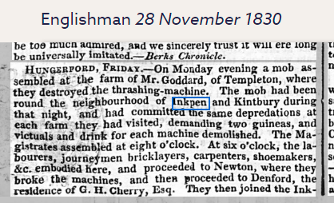

Slide 81
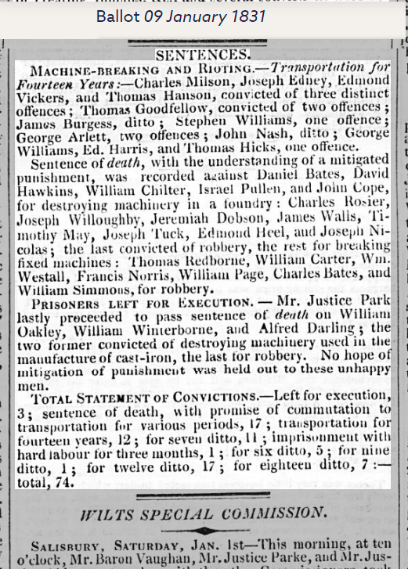

Slide 82
The Crackdown: Transportation & the Gallows
By 1831, the bloody assizes begin:
- Jem Cooper is caught with a smuggled pistol. At Reading Gaol, he’s sentenced to 7 years’ transportation to Australia.
- In Hungerford, two men are hanged for arson. Their bodies are left swinging as a warning.
- The Vicar (now a fat, fox-hunting Tory) preaches that "riots are sins against God and King." Few listen.

Slide 83
The Aftermath: A Broken Village
The riots fail to stop the machines, but they leave scars:
- The Workhouse Grows: With no winter work, families beg for entry—but inside, husbands and wives are separated, forced to eat gruel in silence.
- Methodist Preachers gain followers, promising "salvation for the oppressed."
- Emigration Begins: A few young men, like Thomas’ son Will, book steerage passage to America rather than starve.
A Labourer’s Last Words
On the eve of Jem’s transportation, Thomas meets him in the gaol yard. Jem, gaunt but defiant, grips his brother’s arm:
"Tell our Mary… the Harcourts won’t always rule here. The machines won’t always win."
As the prison ship sails, Thomas walks home past the blackened ruins of the rick. He picks up a broken piece of the smashed thresher—a twisted iron gear—and pockets it. A relic of the revolt. A promise of revenge.

Slide 84
Between 1820 and 1850, the building of the Canal and Railway brings some income to the village, both through work and hospitality.

Slide 85
The Agricultural Depression: "The Land No Longer Feeds Us"
By the mid-1800s, cheap grain imports from America and Canada flooded Britain, driving down crop prices. For Inkpen’s labourers, this meant:
- Lower Wages: Farmhands who once earned 9 shillings a week in the 1820s now got 6 or 7—barely enough to feed a family.
- Loss of Common Rights: Enclosure had left many without grazing land, forcing them to poach or emigrate.
- The Workhouse Looms: The New Poor Law (1834) made relief harder to get. Families dreaded being sent to the Hungerford Union Workhouse, where they’d be split apart.
Old Jem Carter, once a ploughman, muttered: "The corn grows, but our bellies stay empty."

Slide 86
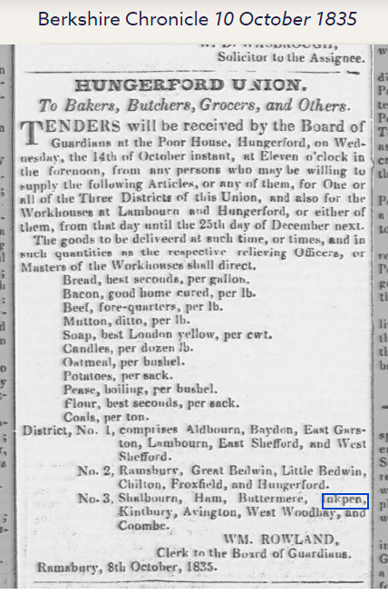

Slide 87
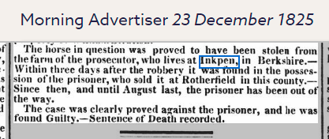

Slide 88
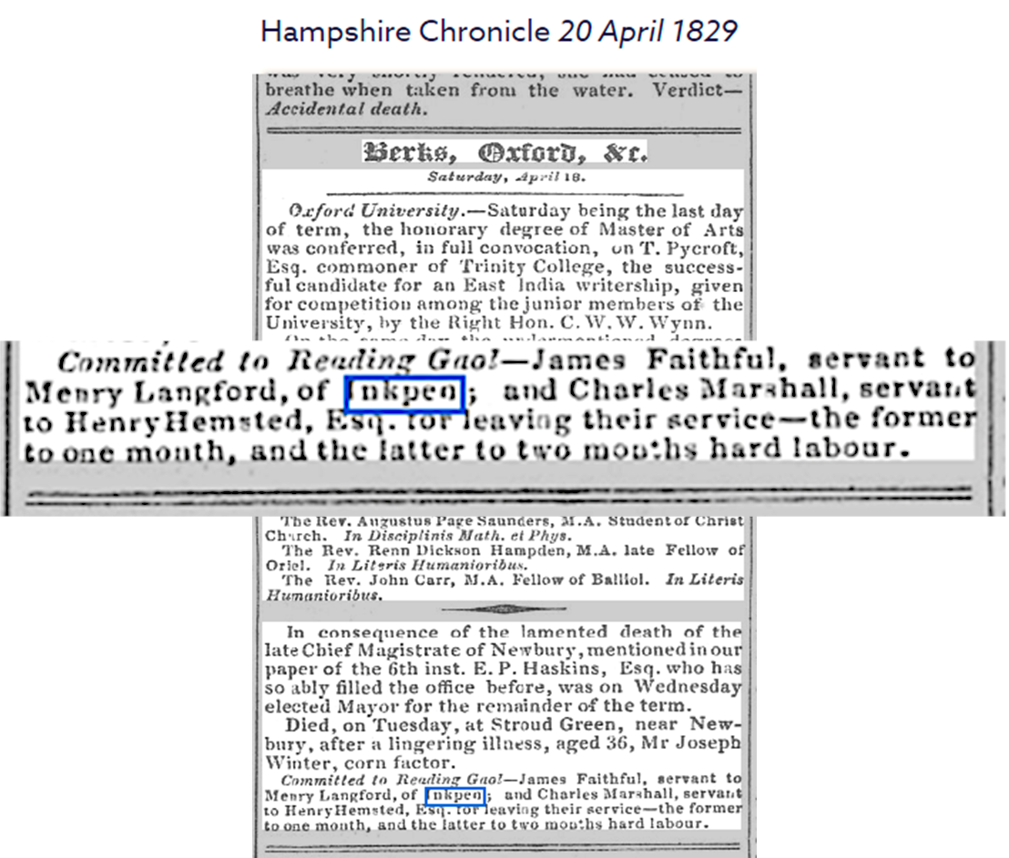

Slide 89
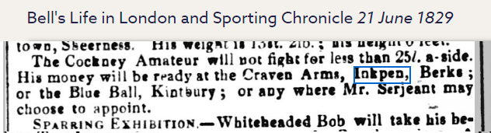

Slide 90
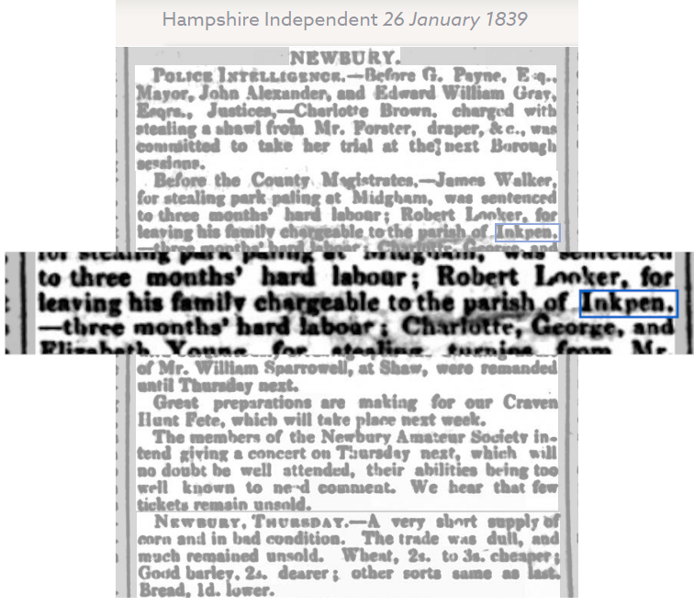

Slide 91
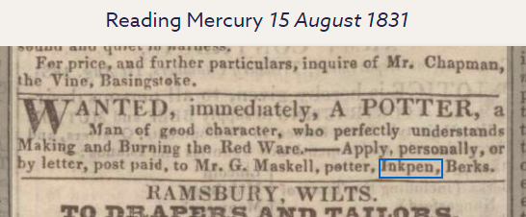

Slide 92
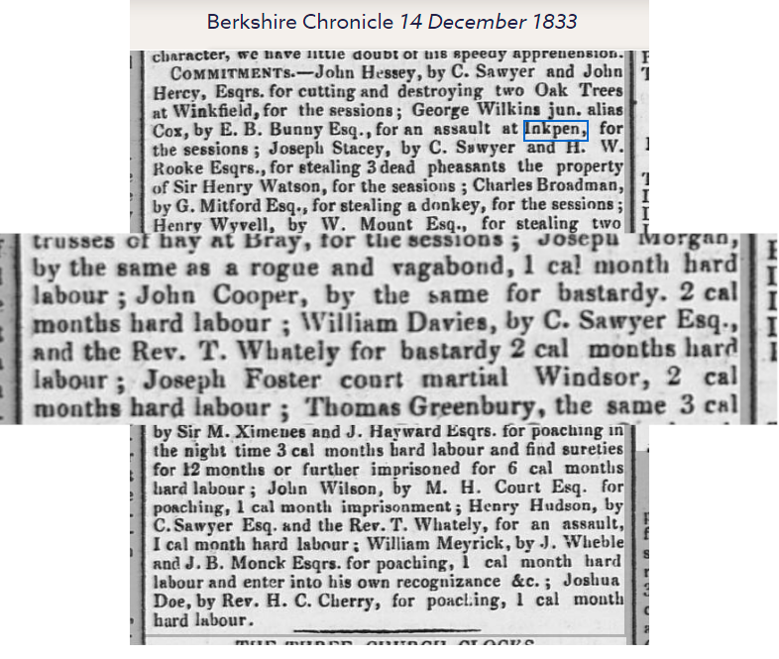

Slide 93
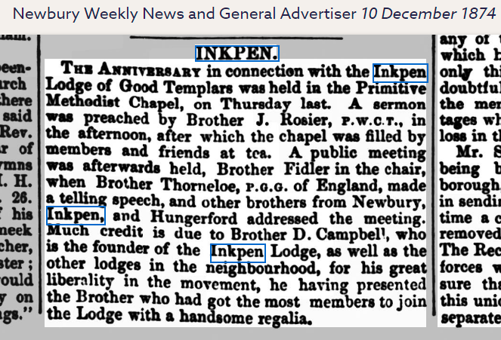

Slide 94
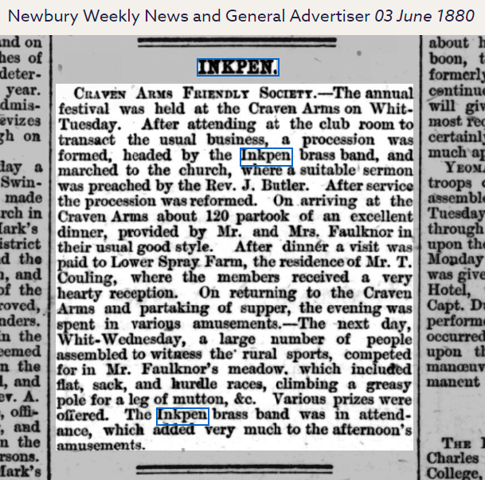

Slide 95
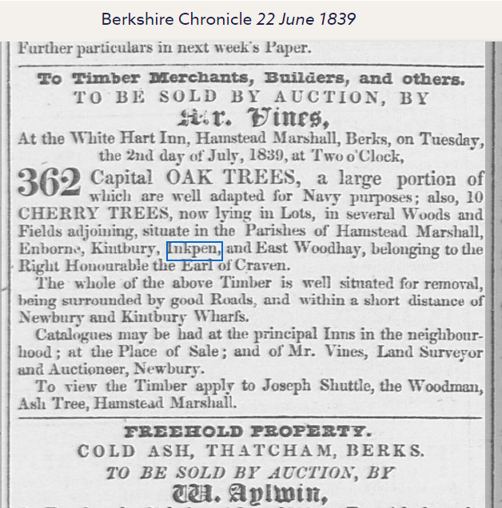

Slide 96
The World at War

Slide 97
The two World Wars transformed Inkpen from a quiet agricultural backwater into a community marked by loss, resilience, and quiet rebellion. While no bombs fell on its thatched roofs, the wars reached into every cottage and field.
The Great War (1914–1918): "The Flower of Inkpen Gone"
The Call to Arms
- August 1914: The young men of Inkpen—farmhands, blacksmiths, the vicar’s son—marched off with the Royal Berkshire Regiment, believing they’d be home by Christmas.
- By 1916, conscription dragged even reluctant sons into the trenches. Harry Cooper, a shepherd, wrote home: "The guns never stop. The mud eats men whole."
The Home Front
- Women’s War: With men gone, Sarah Carter (Harry’s wife) took up ploughing, joining the Women’s Land Army. The village matrons clucked—"unseemly!"—but the fields had to be sown.
- Food Shortages: The Harcourt estate was ordered to grow potatoes, not pheasants. Rationing turned flour into grey, gritty "war bread."
- The Belgian Refugees: Two families from Flanders were lodged in the old schoolhouse. They spoke little English but shared heartbreaking stories of burned villages.

Slide 98
The Loss
- November 1918: The war ended, but Inkpen’s memorial listed 12 names—a devastating toll for a small village.
- The Returned: Those who came back were hollow-eyed. Tom Harcourt (the squire’s heir) locked himself in the manor, drinking. The war had spared his body but not his mind.
Between the Wars: A Broken Peace
- The 1920s: A brief boom, then the Agricultural Depression. Milk prices collapsed; small farms folded.
- The late 1930s: Electricity arrived (though only the manor and vicarage could afford it). The Blue Boar got a wireless, where men gathered to hear Churchill’s warnings about Hitler.

Slide 99
World War Era (1914–1945)
"I drive tractors now. I dig for victory. My husband is gone to war, and I keep the home fires burning. I ration, I repair, I remember. I voted last year. I am tired, but I am heard.“
War brought both hardship and empowerment. A woman in Inkpen might have felt a mix of grief, pride, and newfound agency — especially as she took on roles once reserved for men.

Slide 100
World War Era (1914–1945)
"I fought in France. I lost friends in the mud. Now I train the Home Guard and dig for victory. My son flies with the RAF, and my daughter drives tractors. We ration, we repair, we remember. I voted last year. I stand in silence at the memorial and wonder what peace will bring."

Slide 101
The Home Front
- Women’s War: With men gone, Sarah Carter (Harry’s wife) took up ploughing, joining the Women’s Land Army. The village matrons clucked—"unseemly!"—but the fields had to be sown.
- Food Shortages: The Harcourt estate was ordered to grow potatoes, not pheasants. Rationing turned flour into grey, gritty "war bread."
- The Belgian Refugees: Two families from Flanders were lodged in the old schoolhouse. They spoke little English but shared heartbreaking stories of burned villages.

Slide 102
The End

Slide 105
Appendix 1

Slide 106
References in Norman Times

Slide 107
2/KCAR/6/2 - Estate Records
KCAR/6/2/039 - Combe, Berkshire
KCAR/6/2/039/07 - Early charters and deeds
Title: | Charter
Description: | Grant of a pasture by Nicholas de Ingepenn, son of Gervase, to the Abbey of Bec.
Date: | c.1225

Slide 108
Grant by Walter the clerk (clericus), son of Nicholas de Ingepenne, to Osbert Pinell, of...
Description: | Grant by Walter the clerk (clericus), son of Nicholas de Ingepenne, to Osbert Pinell, of Helme, of all his land between the great cave and the boundary of Saldeburn, and of land in the field of Crawemed in Wohgelande, and of pasture. Witnesses: Geoffrey Salvagius, Peter de Succomund, and others (named). [Henry III.]. [Berkshire]
Date: | 1216-1272

Slide 109
Description: | (St Barnabas); at Kariheys Gift Roger de Ingepenne, knight = (1) Serlo de Lanladron = (2) (1) to (2), all his land of Sanctus Goronus, which he had by gift of Henry de Burne and Emelina his wife, with all appurtenances, namely buildings, curtilages, rents, services of free and bond men, gardens, meadows, pastures, turbaries, tin-works (stagnaria), commons, hills (montani), plains, etc. For (2) and his heirs to hold of the chief lords of the fee freely and hereditarily for ever, doing services due and accustomed to the chief lords, and also paying 10 marks yearly in (1)'s name to Thomas de Sicca Villa and his heirs, at 4 terms, for all services and demands. Sir John de Alet, Sir John de Treiagu, Sir Thomas de Pridias, Sir Reginald de Beuille and knights, Stephen de Bello Prato, Richard de Chambernon, Robert de Geueli, Thomas de Trempol, Walter de Hellond.
Date: | 1290, Sunday 11th Jun
Held by: | Kresen Kernow (formerly Cornwall Record Office), not available at The National Archives

Slide 110
Description:
Petitioners: | Roger de Ingepenne (Inkpen).
Name(s): | de Ingepenne (Inkpen), Roger
Addressees: | King.
Nature of request: | Ingepenne requests delivery of the land of [...] which he gave to the earl of Cornwall for his life, and which were seized into the king's hand after the death of the earl.1)
Nature of endorsement: | Let the extent taken of the earl's death be viewed and if the evidence is found sufficient then another remedy should be provided.2) Walter de Gloucester, escheator said before the council that it was found by inquisition that the earl died seised of the tenement in his demesne by fee because he held of the demise of Ingepenne for the term of his life. Therefore the escheator did not seize the tenement into the hand of the king.
Places mentioned: | Kar[...] [unidentified].
People mentioned: | Earl of Cornwall.
Note: | The petition is dated to 1300-1307 as it appears to be after the death of Edmund of Almaine but still being within the reign of Edward I.

Slide 111
Description:
Petitioners: | ? No Petitioner named
Nature of request: | Memorandum that Roger de Ingepenne and Emmeline his wife demised the lands and tenements mentioned in a writ [apparently formerly attached] to Edmund, Earl of Cornwall for term of life, and that after his death they were taken into the King's hand with his other lands and tenements, where, because Roger and Emmeline have never claimed them, and do not claim them now, they remain.
Nature of endorsement: | [None]
People mentioned: | Roger de Ingepenne (Inkpenne); Emmeline [de Ingepenne (Inkpenne)]; Edmund [of Almaine], Earl of Cornwall.
Note: | This memorandum is in response to a writ quoted on SC 8/202/10085 below and dated 4 February, 29 Edward I (1301). It would therefore seem to date to this year also.
Date: | [1301]

Slide 112
Effects of the Black Death

Slide 113
Key Contrasts
Aspect | Pre-Black Death (1300s) | Post-Black Death (Late 1300s)
Labour | Serfs bound to manor | Free tenants, wage labour
Land Use | Open-field farming | More sheep pastures, enclosure
Population | Crowded, famine-prone | Halved, but wealthier survivors
Housing | Basic timber huts | Improved stone/chimney cottages

Slide 114
Health & Medicine: Before vs After the Black Death
Aspect | Before the Black Death (Pre-1347) | After the Black Death (Post-1351)
Medical Theory | Based on humoral theory (Galen & Hippocrates) | Still humoral, but increasingly questioned; more emphasis on observation
Practitioners | Mostly monastic healers, apothecaries, and barber-surgeons | Surgeons gained prominence; lay healers and women played larger roles
Hospitals | Few and mostly religious hospices for the poor and pilgrims | Growth in hospitals and public health measures like quarantine
Treatments | Herbal remedies, charms, bloodletting, astrology-based timing | Continued use of herbs, but also quarantine, fumigation, and isolation
Understanding of Disease | Believed to be caused by miasma, sin, or imbalance of humors | Recognition of contagion and transmission through contact
Public Health | Minimal sanitation; no organized disease control | Emergence of quarantine laws, urban sanitation, and epidemic response
Medical Education | Limited to monasteries and few universities | Surge in anatomical studies, medical schools, and scientific inquiry
Social Impact | Medicine tied to religion and superstition | Greater secularization of medicine; rise of medical ethics
Life Expectancy | Low; average around 30–35 years | Improved post-plague; survivors lived longer, healthier lives

Slide 115
The Black Death was a brutal catalyst, but it cracked open the medieval worldview and nudged Europe toward a more empirical, organized approach to medicine.
Quarantine became a cornerstone of epidemic control, first used in Italian ports.
Anatomy and surgery gained traction as physicians sought physical explanations for disease.
Medical skepticism grew—Galen’s theories were no longer taken as gospel.
Social mobility increased as labour shortages empowered survivors, improving diets and hygiene.

Slide 116
St. Michael’s Church: Ruin & Revival
Plague Crisis (1349–50)
Priest Died: Likely replaced by a poorly trained itinerant chaplain.
Burials: Unconsecrated mass graves (now under Church Lane?).
Recovery (1350–1450)
Architectural Clues:
  North Aisle Added (1400s): Funded by Winchcombe wool wealth (their merchant’s mark appears on a roof beam).
  Brass Memorials: First post-plague brass (1420) honors Alice atte Well—a widow who donated land to the church.
Folklore: The "Plague Cross" (a now-lost stone in the churchyard) was said to ward off disease.

Slide 117
Church as Community Anchor: St. Michael’s rebuild symbolized hope—but also the rising power of yeomen over lords.
“Yeoman" is derived from the Old English word "ġeoman," which is believed to be a compound of "gawi" (district, region) and "mann" (man), roughly translating to "landowner of middle rank" or "man of the district"

Slide 118
Appendix 2
Henry VIII

Slide 119
Legal Landscape Under Henry VIII
Category | Key Elements
Royal Supremacy | - Act of Supremacy (1534): Declared Henry as Supreme Head of the Church of England. - Ended Papal authority in England.
Religious Legislation | - Treason Act (1534): Made it treason to deny royal supremacy—even in thought. - Act of Six Articles (1539): Reinforced Catholic doctrine despite break with Rome.
Parliamentary Power | - Parliament used to legitimize reforms; statute law became central to governance. - Rise of Henry VIII clauses: Allowed the king to amend laws via proclamation.
Church Reforms | - Dissolution of the Monasteries (1536–1541): Seized Church lands and wealth. - Court of Augmentations: Managed confiscated monastic property.
Legal Administration | - Strengthened Privy Council for efficient governance. - Created new courts (e.g. Court of First Fruits and Tenths) to redirect Church revenues.
Regional Integration | - Act of Union (1536): Incorporated Wales into English legal system. - Expanded royal justice into border regions.
Succession & Loyalty | - Succession Acts (1534, 1536, 1544): Defined heirs and criminalized dissent. - Oaths required to affirm loyalty to Anne Boleyn’s children.
Legal Philosophy | - Emphasis on statute law over canon law. - Law used as a tool of personal and political control.

Slide 120
Henry’s legal legacy was both revolutionary and authoritarian—he reshaped the English constitution, centralized power, and used law as a weapon to enforce loyalty and suppress dissent.

Slide 121
Before & After: Key Contrasts
Aspect | Pre-Henry VIII (Pre-1509) | Post-Henry VIII (Mid-1500s)
Religion | Catholic Mass, monastic ties | Protestant services, monastic lands sold
Land Ownership | Church/manor-controlled | Privatized (yeomen, gentry)
Village Power | Lord + Church dominant | Gentry (Fettiplaces) + yeomen rise
Economy | Mixed farming, common land | Enclosure, sheep pastures expand

Slide 122
Legacy in Inkpen
St. Michael’s Church: Survived Reformation but lost medieval art (whitewashed walls).
Field Patterns: Enclosure left traces in today’s hedgerows.
Folklore: Tales of “hidden monks” at Poughley Priory after dissolution.

Slide 123
Henry VIII’s reign turned Inkpen from a medieval Catholic village into a Protestant, privatised community—setting the stage for early modern Berkshire.

Slide 124
Appendix 3
the plague of 1625

Slide 125
Life in Inkpen Before the 1625 Plague
Agrarian Rhythm: Inkpen was a small, rural parish with a population largely engaged in agriculture. The open field system dominated, with communal farming and seasonal labor cycles.
Manorial Structure: The village was shaped by its manorial estates—Eastcourt and Westcourt—held by local gentry and religious institutions. Tenants worked the land under customary obligations.
Religious Life: St. Michael’s Church was central to community life. Though the current structure dates to the 13th century, it had already become a spiritual and social hub by the early 1600s.
Population Stability: While exact numbers are elusive, Inkpen’s population was relatively stable, with families rooted in the area for generations. The Domesday Book and later records show continuity in landholding and surnames.
Health & Hygiene: Like most rural communities, sanitation was rudimentary. Illnesses were common, but major outbreaks were sporadic.

Slide 126
Effects of the 1625 Plague in Inkpen: Before vs. After
Aspect of Life | Before the 1625 Plague | After the 1625 Plague
Population | Stable rural community with multigenerational families | Sharp decline, possibly 20–30%; some families lost entirely
Agriculture | Communal farming with sufficient labour for seasonal tasks | Labour shortages; possible field abandonment or land consolidation
Land Tenure | Customary manorial holdings; stable tenancy and inheritance patterns | Disrupted inheritance; land reallocated or leased to outsiders
Health & Hygiene | Endemic illnesses; few major outbreaks | Widespread contagion; overwhelmed health response and burial practices
Religion & Church Life | St. Michael’s Church central to community events and spiritual rhythm | Increased pastoral role; possible mass burials and plague sermons
Burial Practices | Individual graves; modest commemorative markers | Surge in burials; some unmarked or eroded stones; communal interments
Community Structure | Interwoven kinship ties and local governance | Fractured families; rise in orphans and widows needing parish support
Architecture | Ongoing repairs; functional medieval structures | Deferred maintenance; later restorations hint at prior neglect
Economic Stability | Subsistence-level economy with predictable seasonal output | Economic strain; reduced productivity and restructured labour dynamics

Slide 127
The historical connections between Inkpen and the broader national shifts during the Interregnum period:
Theme | Details Relating to Inkpen
Local Land & Governance | - Westcourt Manor remained influential; possible impact from Commonwealth land reforms and taxation. - Village structure retained its Saxon and medieval layout.
Religious Life | - St. Michael’s Church likely saw Puritan reforms: simplified worship, suppression of festivals, possible clergy replacement.
Cultural Footprints | - Gallows Down's double gibbet, from the 1670s, reflects post-Interregnum tensions. It was later featured in Black Legend film with local participation.
Historical Records | - Tithe maps, graveyard inscriptions, and audio recordings (1975) maintained by Inkpen History Society. - Possible insights into Commonwealth-era social fabric.
Archaeological Insights | - Surveys by Berkshire Archaeological Society found habitation layers and Saxon remains—evidence of village resilience through turbulent periods.

