Slide 1
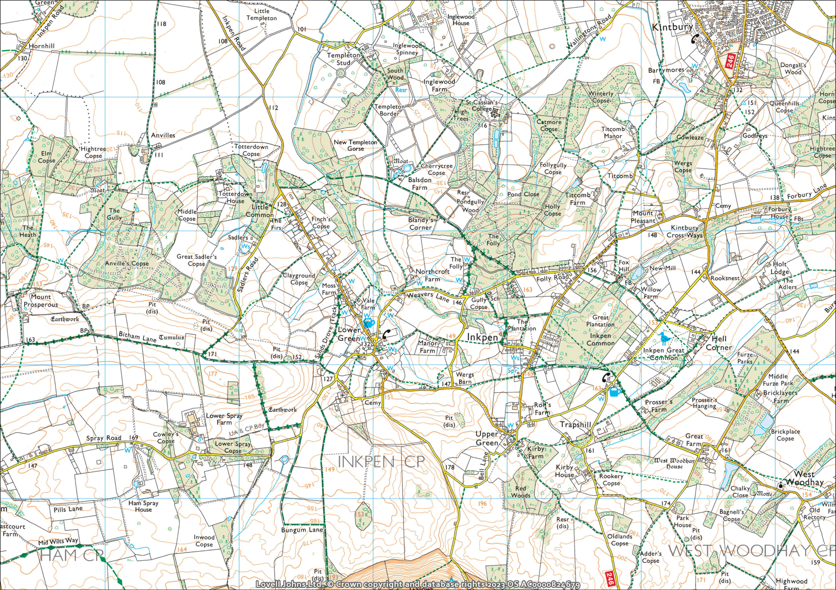
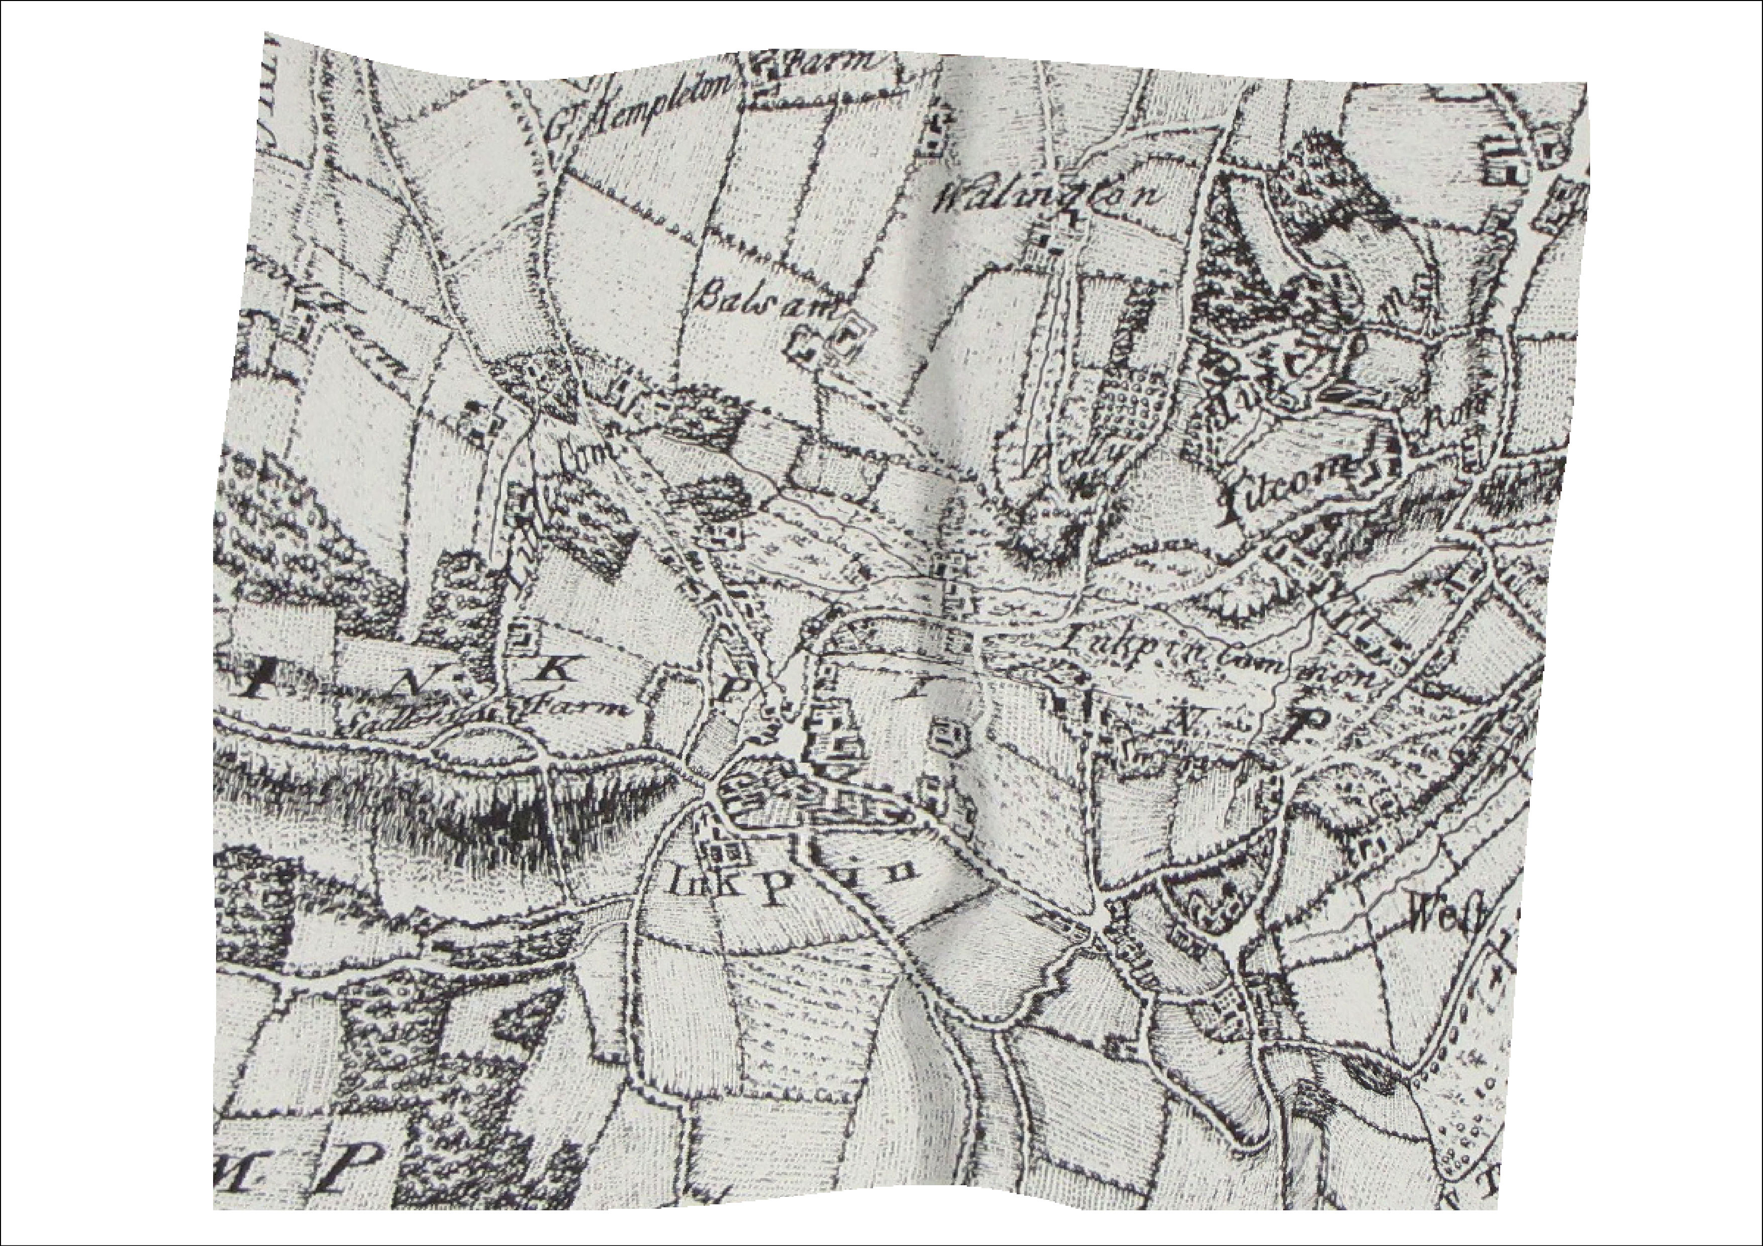
Changes in track/road
Structure present in 1761 but not now
Notes:
12. Route north away from Upper Green, and triangular roads around Trapshill all ok, also road past Kirby House. Buildings on Kirby House site.. Track from Kirby Farm site (not clear if buildings there) to south now approx. follows footpath but spur to Kirby House absent on OS map (note seems like a church located where West Woodhay House is). Current footpath from Upper Green to SE is 50m NE of old map track.
11. Main route towards Upper Green away from Lower Green starts along the footpath; several houses along it and south of Manor Farm. East of where Wergs Barn shown on OS maps, tracks diverge – further south on old map, but converge at Upper Green.Route south to Combe and Bell Lane ok.
10. Roads etc similar. Track heading south is more pronounced than Ham Road – but it diverges to the west at the southern limit of map. Church etc close to OS map locations. But not accurate.
9. Old map much as OS map except Spray Road on western edge of map is100m north of OS map position . Only building is on N side of Ham Road.
8a (east of 8)C&G road to NW is shown clearly as track through Willow Farm, Fox Hill on old map with buildings. Buildings on SE side of footpath at Hells Corner.
8. Many differences in roads. Folly Road is north of the original route. Post Office Road etc absent. Although tracks etc aren’t visible, seems to be several buildings in Pottery Lane area and east of there. Stream locations etc are ok – flowing east.
7. Weavers Lane and road to Manor Farm clear on old map, several buildings shown on Lower Green.. Manor Farm clear. Track north from Weavers opposite Manor Farm road absent but several buildings shown in that area – maybe including The Folly (Marriott’s) but no clear tracks as exist today in area south of area labelled Folly. Stream patterns confused/wrong!
6. Lower Sadlers Farm visible on old map. Craven Road visible – broad at S end, till where the stream crosses it today, then narrows on the old map as it goes NW towards Little Common.Several buildings dotted along the road, with what might be a farmyard complex half way uo, (near where barns are today?). Sands Drove on old map, but no track shown connecting Sadlers Farm and Lower Green, seen on 1873 maps and traces on the ground today.
5. Bitham Lane clear on old map, but around Sadlers Farm (SE corner), it’s very different. Sadlers Road visible but very broad and indistinct as it goes toward Little Common. Wooded areas exactly where they are on OS map – unlike other areas.
4. N-S track from the Folly towards Kintbury present on old map, traces visible on OS (footpath, field boundaries etc). Titcomb obscured to some extent by labelling on old map, but Titcomb manner marked and track leading NW from it, which isn’t seen on OS map. Present day roads SE of Titcomb seen on old map and dwellings around Mt Pleasant visible on old map.
3. Balsdon present on old map but named Balsam. Track to SE from Balsdon om OS map present on old map but none others. (bridleway to SW or footpath to N). Folly marked in SE corner of old map. What might be a track from there to St Cassians (named Wallingtons) shown, but could also be field boundaries brodering a stream. Ponds at present day St Cassians absent.
2. Present day Craven Road visible; to north of Little Common (equivalent to Lower Green) it diverges from route on old map by up to 100m to west
1. Anvilles present and named as such. Totterdown has buildings on site but not named; if georeferencing and old map are ok then might be some old buildings to south of current house location. Current east-west footpath not present on old map. Track to north of Totterdown (not ROW) shown as track continuing to north on 1761 map. Routes rejoin near where east-west track (on both maps) hits Craven Rad at junction with road to Inglewood. Building on old map where current Colnbrook(??) is. Building shown on 1761 map to north of current bridlepath towards Balsdon. Bridleway not on old map. Building also shown in valley NE of Craven Road – none there now – downhill from existing CR houses. Stream in SE shown on old map draining east is fictional – as for other streams inferred.

